Slide 1
Welcome to NNESHRM
Fall Education Day!
November 18th, 2024
Harraseeket Inn, Freeport, ME

Slide 2


Thank you for being Diamond Level Sponsors!

Slide 3

Thank you for being a Platinum Level Sponsor!

Slide 4





Thank you for being Gold Level Sponsors!

Slide 5




Thank you for being Silver Level Sponsors!

Slide 6

Risk Management Pot Luck:
Stuff I Learned Along The Way….
Barbara McCarthy RN, MPH, CPHRM, DFASHRM
(Retired) Enterprise Risk Officer, Beverly Hospital, member BILH
ASHRM President 2022
bmccarthy1025@gmail.com
NNESHRM
November 18, 2024

Slide 7

Objectives
Identify practical risk management strategies that can be successfully repeated & reinforced
Provide clinical & non-clinical examples of applying risk management principles
3. Facilitate a learning environment that can be a
resource to operational leaders

Slide 8

Risk Is Not All Bad….
Risk Management: Identifying, assessing, & responding to uncertainties that may compromise the organization’s ability to achieve it’s objectives and more importantly, being in position to take advantage of opportunities that add value
Adam Grant:
Progress always involves risk. You can’t steal 2nd base & keep one foot on 1st
Saying “no” frees you up to say “yes” when it matters most
Drucker
A decision that doesn’t involve risk, is probably not a decision
Jack Welch
If the pace of change on the outside is faster than the pace of change on the inside, the end is near
Be bold & fail forward.....

Slide 9
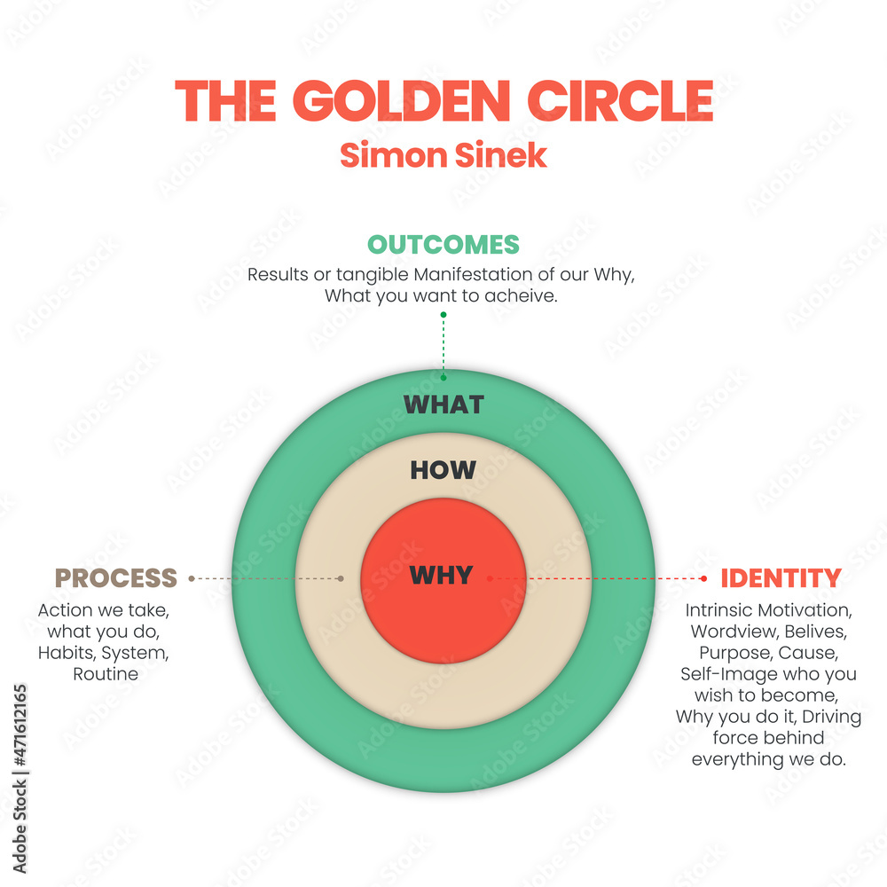
Start With Why: How Great Leaders Inspire Everyone to Take Action
Simon Sinek (2009)

Slide 10
It’s Culture, really!
Oriental cliché - ‘you can’t carve a statue from rotten wood’….
Risk culture
Organizational culture
Behaviors
Personal predisposition to risk
Personal ethics
Institute of RM Framework

Slide 11
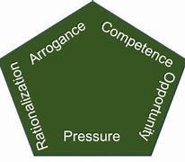
Sadly, the Fraud “Pentagon” Can Creep into our Risk Culture

Slide 12

Ethics
Safety & quality is a continuous process, but little has
been done to connect ethics to patient safety.
John Donnellan connected ethics to IOM’s quality aims – to promote shared decision-making among patients, families, & providers; patient-centered care.
Examples:
Breached confidentiality vs health interest of an employee exposure/PEP
Patient self-determination vs duty to avoid public health threat
Resuscitation in the face of a DNR order…
Adverse outcome – consider ethicist’s skills for mediation, “working the gray”, team coaching, RCA queries, &/or active communication
Ethical dilemmas hidden in incident reporting systems & analysis - restraining patient to prevent harm to surgical site/lines vs loss of freedom
John Donnellan FACHE/Jason Lesandrini FACHE (HC Exec Mag Mar/Apr 24)

Slide 13
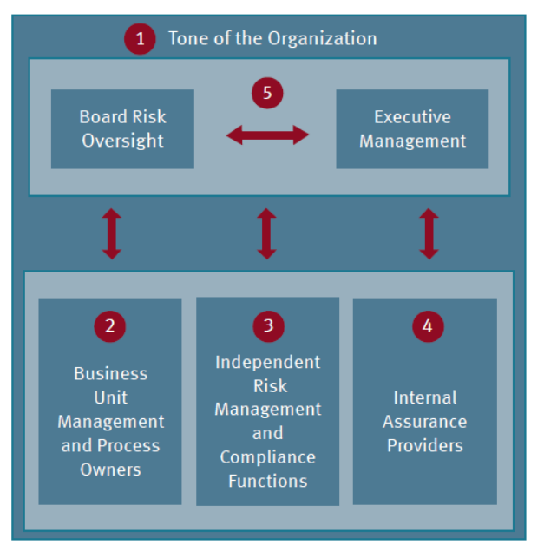
Where Does Everyone Fit In?
6
External Auditors & Regulators
Applying the Five Lines of Defense When Managing Risk. Protiviti, 2021. Found at: https://www.protiviti.com/US-en/insights/bulletinv5-i4

Slide 14




Teaching From the News
PM Schedule/Compliance
Stop the Line
Emergency Response
Speaking Up
Fair & Just Culture
Detailed RCA

Slide 15
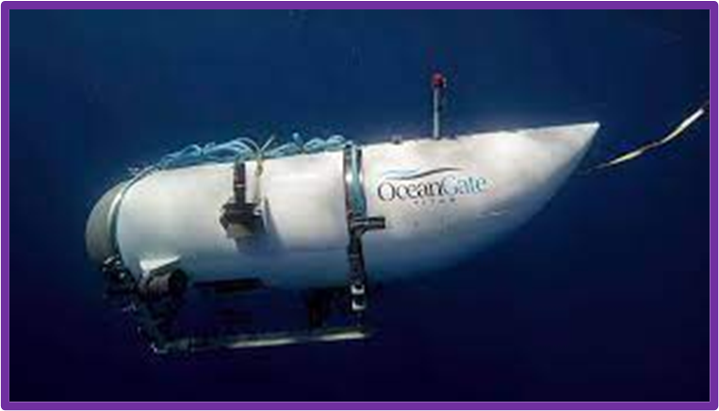

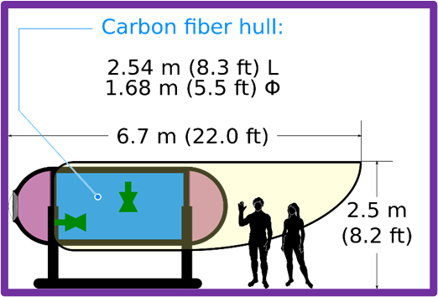


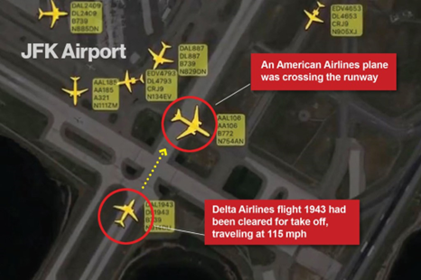

More Teaching from the News

Slide 16

Animals of the Risk World
Unpredictable
Unexpected & unknowable
Challenges our system of thought
Extremely severe &/or widespread consequences
After the occurrence, people will rationalize the event as having been predictable (known as hindsight bias)
Do not rule out a black swan just because you’ve only seen white ones before

Slide 17

Relative of the Black Swan….
Threats that should be obvious, highly probable & potentially devastating if not prepared.
All to often neglected, avoided, or ignored
We are terrible at paying attention &/or changing fast enough – human nature &/or social/business dynamics
The systems we’ve set up make it harder for us to act
What you put up with or tolerate is what you stand for…

Slide 18

Incident Reporting System
We beg colleagues to report….
Too many mandatory fields = too hard, don’t do it
If they do report, no feedback = “why report, it just goes into a black hole”
System Intent – early warning signs, big thinking, common contributors = but reporting is rarely proactive
Variable file management = incorrect incident type, severity, no action plan, no file closure
Poor file management = misleading data, can’t trust trend lines, lot’s of noise, needle in a haystack
Need a reliable/closed loop system to successfully use the data to make improvements & monitor trends
Need consistent way/s to give feedback to colleagues about their reports & how we’ve used them
Just culture…safe reporting Maybe AI Can Help?

Slide 19

Case &/or patient details outside of Peer-Protected Committees & incident system are all discoverable

Slide 20

To do things differently, we must see things differently. When we see things we haven’t noticed before, we can ask questions we didn’t know to ask before
John Kelsch, Xerox

Slide 21

Data Sources
Internal
Strategic Plan
Culture Survey
Leapfrog/CMS scores
Regulatory findings
Incident reporting trends
Grievance trends
Claims/suits
Committee topics
External &/or Professional Associations
Insurer RM (i.e., CRICO, Coverys)
AHA, AORN, ENA
ASHRM, RIMS
ACHE, HCCA, AHIMA, NAHQ
PwC/KPMG
ECRI
Protiviti, AXA
Fun (Scary) Fact: The healthcare industry generates 30% of the world’s data volume. By 2025, it is expected to top 36%.
RBC Capital Markets

Slide 22
CIR Summary – 4 year comparison
Example: Internal Data Source
Event type | FY20 N=16 | FY21 N=16 | FY22 N=15 | FY23 Q1/Q2 | Trend/Comment
Suicide/Self injury attempt | 6 | 4 | 6 | 1 | Inpatient behavioral health
Pt/Staff assault |  | 2
Pt-Pt assault | 1 | 1 |  | 1 | Inpatient behavioral health
Medication | 1
Delay dx/tx | 2
Lab/Path related | 1 | 2 |  | 3 | Path Lab, CT, Mat
Radiology |  | 1
OB events | 2 |  | 1
Sterilization/Disinfect.
Unexpected death/change in status | 1 | 1 | 1
Elopement |  |  | 1
Pressure ulcer |  |  | 1
Retained object -Near miss |  |  | 1
Misc. other | 2 | 5 | 4 | 3 | OR tissue freezer, CV adult code, ED trauma stat blood order

Slide 23
Top Risks – North Carolina State University
Example: External Data Source
2023 | 2032
Succession planning | Succession planning
Growth restriction due to economic conditions | Skill set challenges with adoption of digital tech
Profit/Loss impact of increased labor costs | Rapid speed of disruptive innovation/tech outpaces org ability to compete
Resistance to change making business changes difficult | Resistance to change making business changes difficult
Continued supply chain uncertainty | Privacy/compliance with growing ID protection expectations will require more resources
Difficulty sustaining culture with changes in work environment | Existing operations/IT unable to compete with “born digital” competitors
Skill set challenges with adoption of digital tech | Inability to use big data/analytics may limit goal achievement, productivity/efficiency
Lack of timely ID/escalation of risk issues – due to org culture | Growth restriction due to economic conditions
Negative impact on retention due to location of work (remote, hybrid, WFH) expectations | Regulatory changes/scrutiny may impact how org deliver products/services
Org. not resilient/agile enough to manage unexpected crisis | Profit/Loss impact of increased labor costs

Slide 24
Top 10 Emerging Risks - AXA
 | 3,200 Risk Experts/50 Countries |  | 20,000 members
1 | Climate change | 1 | Climate change
2 | Cybersecurity | 2 | Pandemics & infectious diseases
3 | Geopolitical instability | 3 | Cybersecurity
4 | Risks related to AI & big data | 4 | Social tensions & movements
5 | Energy | 5 | Energy
6 | Natural resources/biodiversity | 6 | New security threats/terrorism
7 | Financial stability | 7 | Financial stability
8 | Social tensions & movements | 8 | Pollution
9 | Pandemics & infectious diseases | 9 | Geopolitical instability
10 | Macroeconomic | 10 | Natural resources/biodiversity
Example: External Data Source

Slide 25


https://www.aha.org/environmentalscan https://www.shsmd.org/resources/futurescan-2022
file:///L:/RM%20Committee%20FY2023/2023%20Summer%20Series/Origami_State%20of%20Risk_2023.pdf

Slide 26

Strategic Due Diligence
Risk coming TOWARD the Strategy
Risk of executing the strategy
Unintended/unrelated consequences of the strategy
Risk coming FROM the Strategy
Risk profile of the strategy
Implications/assumptions associated with the strategy
Doesn’t align with risk appetite
Risk OF the Strategy
Risk not moving the organization where it needs to go
Strategy does not align with mission/values
Even if done correctly, the strategy won’t help reach the goal

Slide 27
Assessment Formats
SWOT – top-down view: your area, a dilemma, business proposition
FMEA – steps, failure modes, scoring, re-imagining a workflow
New procedure, service line, equipment risk assessment
CIR – near-miss investigation, non-reportable to regulatory agencies
RCA – serious reportable event (SRE) investigation, reportable
HVA – Hazard Vulnerability Assessment, Emergency Management
Safer Matrix – Environment of Care/Joint Commission
*****************
Goals: (1) slow down, minimize jumping to conclusions (2) do more FMEA than RCA

Slide 28

SWOT Analysis (“SW” – internal, “OT” – external)
Strengths
Weaknesses
Opportunities
Threats

Slide 29

Failure Mode & Effects Analysis (FMEA)
Proactive risk assessment of a care or service process
Identify steps in the process
Identify failure modes (what could go wrong) for each step
Assess for Severity (S), Occurrence (O), & Detectability (D) for each failure mode
  S x O x D = Risk Priority Number (RPN)
Rank RPN in descending order
Develop action plans to mitigate/reduce highest risk step
Examples:
Trauma Stat Blood Release
Safe Food Trays for Suicide Risk Patients
“Forms Management”
Med Rec
Observation Status

Slide 30
Example: Trauma Stat Blood Release
Turquoise= new Process Steps
Step | Step
EMS notification to ED | EMS notifies ED MD or Charge RN from the field. Determination of trauma team activation.
ED Trauma activation | Charge RN or AA notifies Switchboard of: Trauma level, age, gender, ETA & brief mechanism of injury Switchboard initiates “Trauma STAT” notification to multi-departments. Blood Bank receives notification; begins preparing 2 units O +/- based on age/gender information. Charge RN notifies Access Rep of “Trauma STAT” with age & gender info
Access/Registration | Access rep uses “Unidentified Patient ” process to complete registration pre-arrival – 100% of cases
Orders | MD or RN enters “Trauma Stat” order set once registration done
Blood delivered | Blood bank can deliver “Emergency Release” O +/- as soon as ready
Patient Arrival/Assessment | Patient arrives; EMS report to ED team. Provider assessment begins
Access/Registration | Access rep documents arrival in EPIC. Completes demographic update request form & marks record for merge with prior record

Slide 31

Example: Medical Records Forms Management
  Consents
  Downtime forms: Order sets, Med Administration Records (MAR), Progress Notes, Flowsheets, Admission Assessments, Care Plans, Code Sheets
Problem……
1. Source documents found in multiple locations:
  I-drive (historic source of truth)
  ECMS Careforms (links to EPIC), 2015 – prints with patient name/demographics
  G-drive (department drive)
  File cabinets and dusty shelves
2. Form revisions not managed & forms not retired
3. Owners come & go
4. And the elusive form fairy
Resolution:
Single Source of Truth
Data Governance oversight

Slide 32
New Service/Program, Equipment, Procedure Risk Assessment
Completed:
In Process:
TBD:
Domain | Key Activities |  | Domain | Key Activities
Finance | Cost/Benefit analysis, pro-forma, budget/cash flow Reimbursement Capital Equipment Supplies/disposables Staffing/training impact, implementation |  | Human Capital | Credentialing & privileging plan Staffing changes, recruitment plan Job descriptions, training, preceptor Competency assessment & re-assessment Peer review process Vendor support
Patient Safety | Inclusions & exclusion criteria R/B/A Emergency Response Literature, litigation, & ECRI/FDA Searches Metrics & process/outcome tracking FMEA indication |  | Technology | Epic templates & changes, documentation Network connections Remote access/security agreements Clinical Engineering support Service Agreements Image storage/privacy
Operations | Business Plan Sponsor, Steering Committee, daily oversight Clinical guidelines, consents, P&P Patient education materials Campus/space, storage Infection Control & Safety controls Interaction with/impact on other departments Approval process – HIM, RM, PI, MEC, BOT, other |  | Legal Regulatory | Licensure Contracts, BAA Regulatory review – DPH, TJC, other Liability coverage – providers, organization Stark, anti-kick-back Conflict of Interest
Hazard | Age of plant – facility accommodations Supply chain delays Business interruption Adverse weather impact |  | Strategic | Organizational fit – mission, values, goals Success factors Marketing plan Internal/external communication plan
Low bar for when to initiate/call RM - as much notice as possible - anyone can initiate

Slide 33
Enterprise Risk Management (ERM)
ERM Domains | Examples
Operations | P&P, protocols, workflow, business interruption
Patient Safety | Errors, adverse events
Strategy | Reputation, competition, disruptors, failure to adapt, M&A
Finance | Litigation, capital, P&L, financial ratings, rev cycle
Human Capital | Labor market, competency, employee safety, culture
Legal/Regulatory | Licensure, accreditation, DPH/CMS, fraud, compliance, privacy
Technology | EMR, cyber liability, medical/non-medical equipment
Hazard | Disaster planning, age of plant, construction
ERM – simply a way of doing business & thinking about risk beyond patient safety

Slide 34
Top 10 Risks: RM Committee Sept 2021
Example: my former organization
 | Domain | Risk
1 | Human Capital | Staffing – recruitment & retention
2 | Operations | Behavioral Health volume/ED boarding (adult & pediatrics)
3 | Operations | Overuse of copy & paste documentation
4 | Patient Safety | Monitoring of ED Waiting Room patients
5 | Strategic/Finance | Funding for aging infrastructure vs clinical equipment
6 | Human Capital | Novice 11-7 workforce
7 | Technology/Operations | Common platform for bed tracking = delayed tertiary transfers
8 | Operations | Medication Reconciliation
9 | Operations | Volume & complexity of policies/procedures
10 | Strategic | Local vs system control/autonomy – it’s effect on innovation, creativity, engagement, & change management

Slide 35

FY23 RM Goals & Priorities
Use Domains….
Domain | Priorities/Initiatives | Status Mid-Year & End of Year
Finance | CRICO/RMF OB Patient Safety Initiatives PSO/PSES – Convening Session Litigation Support CRICO/Underwriting – on-boarding of new PPGs
Patient Safety | Legal Implications of Virtual Care/Telemedicine CRICO Service Line Assessment – AGH/BH ED Suicide prevention/mitigation plan Stroke Program
Operations | Policy & procedure – FMEA
Hazard | Work with Security & Safety Committee on 3rd party Risk Assessment
Human Capital | RM Summer Lecture Series
Technology | Work with CISO to publish emergency response activation for cyberthreat/ransomware event
Regulatory | Monitor COVID-related litigation trends Joint Commission survey
Strategic | New practice &/or program integration BILH system participation – Patient Safety group, PSO

Slide 36
MedRec Action Plan
Use Domains - don’t overlook any components
Domain | Key considerations
Regulatory | Joint Commission requires - “good faith effort”
Technology | Leverage EPIC to work for us, i.e., screens, access
Strategic | Who needs full Medication Reconciliation? When is done “done”? Will it work for at least 80% of Inpatient/Observation?
Operations | When? Where? Staffing/coverage? Task sequencing? Data sources? Role delineation? Expectations & Accountability? Avenue to include patient/family? Importance of list to/from EMS & sending facilities?
Human Capital | Who? Who is best? Minimize duplication of efforts Improve team communication
Clinical/Patient Safety | Improve quality of patient med list What is the impact of incomplete or imperfect process? Are there acceptable level(s) of failure?
Financial | TBD – any business plan for FTE changes/resources

Slide 37
Supply Chain Risk List Barb McCarthy (ASHRM), Mary Beth Briscoe (AHRMM) & Mike Schiller (AHRMM) 2020
ERM Example – non-clinical inventory as Step #1 toward prioritizing top risks
Financial | Human Capital | Pt. Safety | Technology | Operations & Hazards | Legal & Regulatory | Strategic & Reputational
Bidding wars for scarce items | Labor action | Sub-optimal substitute (no QC, adverse outcomes) | Unique ID not universally adopted | Unpredictable sources, lack of standardization, no redundancy | New requirements &/or regulations | Lack of a global approach to supply chain resiliency
Negative impact on revenue & margin | SC labor outside of country – unable to return | Sub-optimal substitute (patient exposure) | Sub-optimal data analytics (usage, inventory, forecasting | Variable definition of supply chain | New importance of SC regulations (i.e., EUA, DPA , HTS) | Geopolitical impact (tariffs, currency, trade agreements, supply & demand) on the SC
Small cap vendors most at risk of disruption | Clinical demand for best products (i.e., N95) | Lack of substitute (delayed care, ethical decisions) | Inconsistent adoption of Point of Use technology | Hard to “sustain the pain” & hardwire lessons learned so long-term changes are made | Potential for increased recalls/hazard alerts & SMDA reporting | National stockpile – empty
Supply chain = 1st place to cut cost | Clinical acceptance (VAC, provider preference, align w/ existing &/or EBP) | Lack of clinical integration | Re-processing challenges w/ new conservation requirements | Never had to practice/drill a SC disruptions | New accreditation & licensure issues | Lack of a national approach to SC
Extended length of contract/pricing | Culture change (“required” training on supplies/PPE) |  | Increased use of single-use re-processing | Vendor assessment & performance | Outdated business continuity plan (BCP) w/ potential for disruption caused by SC | Sub-optimal foreign manufacturing environment/quality
GPO = single source, risk that product unavailable | Training on multiple/substitute products |  | New risks of cyber attack on SC | JIT production, shipping delays | Increased risk of fraud | Human rights impact of foreign manufacturing
Increased cost of (days-on-hand) | SC leader incentives = cost savings |  |  | JIT inventory, what to stock, where, par levels, hoarding | Impact of SC on PL/D&O litigation | Healthcare unprepared for surge in supplies
Increased warehouse costs | WC/employee exposure impact |  |  | Outdate management |  | Lack of internal ERM approach to SC
 |  |  |  | Lack of storage space & environmental controls

Slide 38
Inpatient Behavioral Health Risks IBH Leaders: C. Vu, S. Gillespie, M. Tarmey, M. Blaney, D. Mason, B. McCarthy (2021) ERM Example – service-line inventory as Step #1 toward prioritizing top risks
Financial | Clinical/ Pt. Safety | Human Capital | Operations | Technology | Legal/Regulatory | Strategic
Low per diem rate | Suicide | Patient-on-caregiver assaults | Progressively longer inpatient psych LOS | Tech is risky in IBH settings (i.e., patient phones) | Patient required to have legal status before they can be admitted | BRH: physical plant at end of life (55 years old) lease up May24
Per diem does not cover all expenses | Patient-on-Patient assaults | Unchanged staffing model despite acuity | Decreased access to state hospital beds | Lack of IT resources for IBH | Patient attorney involvement slows timeliness &/or ability to treat | Where does IBH sit in our service portfolio?
Per diem includes MD fee | Elopement | Siloed recruitment by discipline | Patient placement constraints (double & triple rooms) | Epic functionality must be built or modified for IBH use | No MA law/regulation allowing for medication enforcement as an outpatient | What is IBH reputation in the organization?
ED boarders not recognized in reimbursement system | BRH: lack of Rapid Response Team | Volume of novice caregivers | All policy & practice must be modified or adapted for psych environment | Lack of personal staff duress alarms | Prolonged legal system intervention if patient refuses care | What is IBH reputation in the community?
Under-insured &/or ineligible population | Psychopharmacology | MD recruitment | Lack of reliable acuity metrics for psych nursing | Lack of hallway & common area video | Patient consent required to administer psych meds | BILH/AG agreement to maintain services ends Mar24
Reliance on OT | Patient death in restraints | Lure of private & FFS practices | Prolonged/decreased D/C options | Lack of badge or keyless access | Tight HIPPA/privacy restrictions | BILHBS geography not aligned across settings
Vulnerable for denials & claw-backs | Concurrent psych/medical complexity | Fewer nurses graduating | (New) ED Psych Management Gateway Jan23 | Manual checks system | Tight MA regulatory oversight (licensure, dual reporting, staffing requirements)
Readmissions penalized | Lack of objective scientific markers for disposition |  |  |  | Strong community advocacy (Disability Law Center, NAMI)
No correlations between RVU & provider payment | BRH: lack of medical consult services (podiatry, orthopedics, endocrine, neurology) |  |  |  | Cumbersome complaint process
 | Struggle between ligature resistant environment & medical equipment needs |  |  |  | Complicated & statutory human rights process

Slide 39
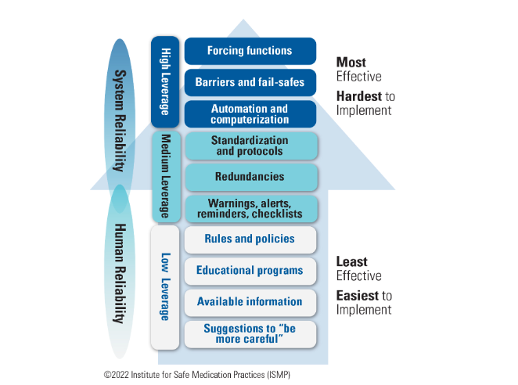
RCA/CIR Actions/Strengths

Slide 40



Lead From Where You Are – Just Start Somewhere
Do a SWOT analysis – thoughtful & realistic assessment of status or current state
Pick your favorite assessment tool – they all provide structure, no jumping to conclusions
Think in all domains all the time – it’s more than clinical/patient safety
Operational leaders rock – they know their risks better than anyone
Show value by being able to see around corners…emerging risks & trends
Micro vs. Macro – start small, easy/quick wins, builds support, natural areas of cross-over

Slide 41

“The Art of War” & ERM
Grace Crickette, Teachings from Sun Tzu (Risk Insider 2014)
No Land Grabs - Just Win the War
It’s not just Risk Management, it’s Change Management
Use your “best” data - don’t wait for perfect, don’t miss the opportunity
Stay sharp - understand the situation, people, conditions, & events
Prepare - anticipate questions, challenges, responses
Don’t solve - ask questions, acknowledge, “listen” is just rearrangement of the word “silent”
Let folks talk - don’t interrupt, unless there’s question – there’s no reason to speak
Do a SWOT Analysis - be reflective, is it too good to be true, never waste a crisis
Pick your battles - those who show interest & those who will have measurable results
Publish victories, findings, activities early/often – highlights all the good work & shows (+) impact on solving problems
Be flexible – have a menu of tools/tips/strategies vs fully sequenced program
Meet, connect, walk-around - your desk is a dangerous place to work
Ask an upside question: “how do you know you are managing your area’s operations well?”
Culture is like the weather - document current state & let it shape the next steps

Slide 42


Some Common Distractions
Mind Drift – not focusing on the task at hand
Routine – doing the same thing over & over can cause you to be less-aware
Overconfidence – sometimes bad habits don’t result in consequences - but they can & sometimes do
Complacency – doing the same job for a long time, can prevent you from looking at the hazards around you
Gasaway

Slide 43

Do you know these people?
Have you heard this before?
Unfortunately, inattention to chronic or repeat behaviors is our biggest mistake & hardest thing to deal with as leaders
I’ve always done it this way & nothing bad has ever happened
I’ve told 5-people the policy doesn’t work & no one listened
I don’t know what you’re talking about .. I only forgot to mark the surgical site. My patients & co-workers love working with me
Everyone else does it that way
Phew – we dodged another bullet
I know it was wrong, but I did it for the right reason

Slide 44

Things to Think About
A candle loses nothing by lighting another candle (Italian proverb)
If you can’t explain it simply, you don’t know it well enough (Albert Einstein)
We can not solve problems with the same thinking we used to create them (Albert Einstein)
To achieve great things, two components are needed. A plan & not quite enough time (Leonard Bernstein)
If you get to thinking you’re a person of some influence, try ordering around someone else’s dog (Old Farmer’s Advice)
12 days without chocolate. Lost hearing in my left eye.
Sorry, I didn’t mean to push all your buttons – I was just trying to hit mute…..

Slide 45

Why ERM Doesn’t Stick
Governance & leadership - no stakeholder or champion, no framework
Knowledge – we already do it, passing fad
Culture – dislike transparency
Risk Appetite – fearful/cautious
Difficulty prioritizing – initiative fatigue
Process – too simple, too complicated, overlap, cadence/timing
Silos – budgeting, goals, strategy
Turf – RM, Quality, Compliance, IA, Legal, Finance
Single message for everyone doesn’t work
Difficulty determining ROI
Resources

Slide 46

RM/Leadership Book List
Title | Author
Fearless Organization | Amy Edmundson (Also Right Kind of Wrong: The Science of Failing Well)
Start with Why | Simon Sinek (also: Find Your Why, Leaders Eat Last, Infinite Game)
Thinking Fast & Slow | Daniel Kahneman (also: Noise)
Dare to Lead | Brene Brown (also: Daring Greatly)
Five Days at Memorial | Sheri Fink (disaster planning/leadership during Katrina)
Measure What Matters | Rachelle Garcia
Emotional Intelligence | Daniel Goleman (also: Primal Leadership)
Design of Everyday Things | Don Norman
The Art of War | Sun Tzu
Nudge | Richard Thaler & Cass Sunstein
Power of Habit | Charles Duhigg
The Organized Mind | Daniel Levitin (also: This is your Brain on Music)
The Three Only Things | Robert Moss
Gray Rhino | Michele Wucker
Risk Intelligence | Dylan Evans
Think Again | Adam Grant (also: Originals)
The 21 Irrefutable Laws of Leadership | John Maxwell
Leading Well from Within | Daniel Friedland
Leadership in Turbulent times | Doris Kearns Goodwin

Slide 47

But RM ain’t all doom & gloom – just sing!
High Risk Insurance – Ramones
The Safety Dance – Men Without Hats
Danger Zone – Kenny Loggins
Take Out Some Insurance – Jimmy Reed
Riders on the Storm – The Doors
Flirtin’ with Disaster – Molly Hatchet
Shelter from the Storm – Bob Dylan
Security – Otis Redding
Insurance Man for the Funk – Bernie Worrell
Rock You Like A Hurricane – Scorpions
Trying to Reason with Hurricane Season – Jimmy Buffett
Bonus Track: Stormy Weather – Etta James
Playlist by: Morgan O’Rourke, RIMS Magazine Editor in Chief

Slide 48

Talk to me….and I will forget
Show me….. and I will remember
Involve me……and I will understand
Step back……. and I will act
Confucius

Slide 49


Even busy boats need a rest…….
Thank You!

Slide 50
Please Note
This material was created for NNESHRM’s Conference.
Republication or reuse of the material without the permission of the primary speaker is prohibited.
Thank you.

Slide 51
Take a Break!
Back in 10 Minutes

Slide 52

Dynamic Appraisal of Situational Aggression (DASA) in the Emergency Department
Amy Costigan, MD, FACEP
Janell Forget, RN, BSN, JD, CPHRM, FASHRM

Slide 53
Disclosures
We have nothing to disclose.

Slide 54
Objectives
Recognize the role for a risk assessment tool to help identify patients at risk for violence and aggression.
Describe UMass Health’s experience and lessons learned with Dynamic Appraisal of Situational Aggression in their emergency departments.
Assess the implementation, correlation, outcome, and equity data associated with the DASA project.

Slide 55

If you could identify which patients were going to get aggressive and commit violent acts before it happened…

Slide 56

Risk Assessment Tools
Goal is early recognition of escalation & early intervention to prevent violent or aggressive event

Slide 57
Risk Assessment Tools in the ED
Paucity of high-quality research using violence risk assessment tools in the emergency department setting.
Most tools are established in behavioral health environment
Some small attempts at creating ED specific tools
Not enough data to support using one tool over the other.

Slide 58

“Research on the use of these tools or possibly the development or validation of a new ED-Specific tool is needed. Ongoing, multicenter NIH-funded studies (ED-SAFE, ED-STARS) are developing ED-specific suicide screening tools. Similar work is needed for workplace violence, mass violence, and homicide.”

Slide 59
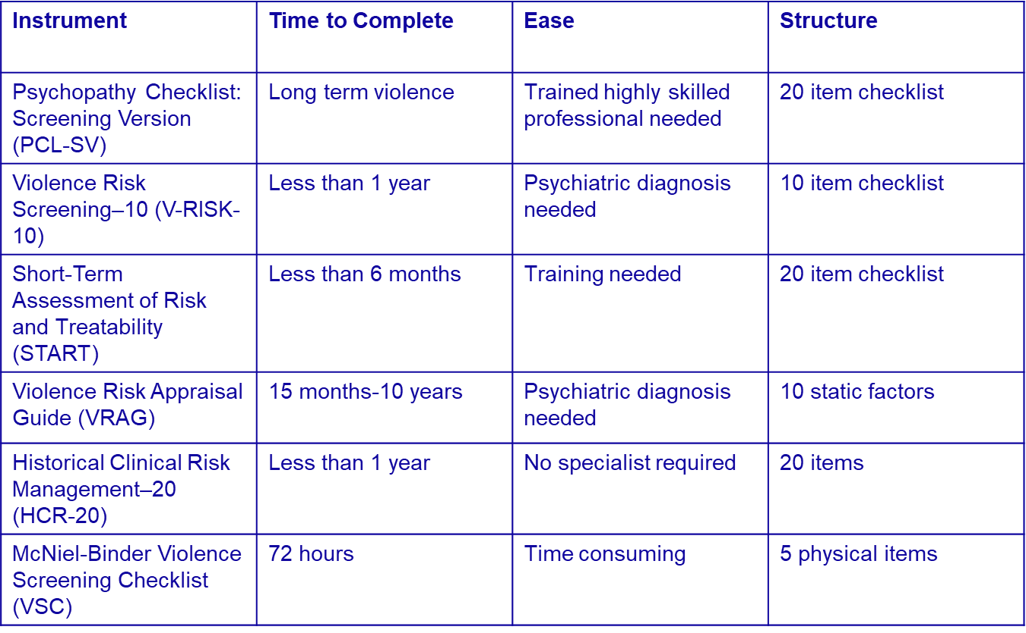
Inappropriate Assessments for ED

Slide 60
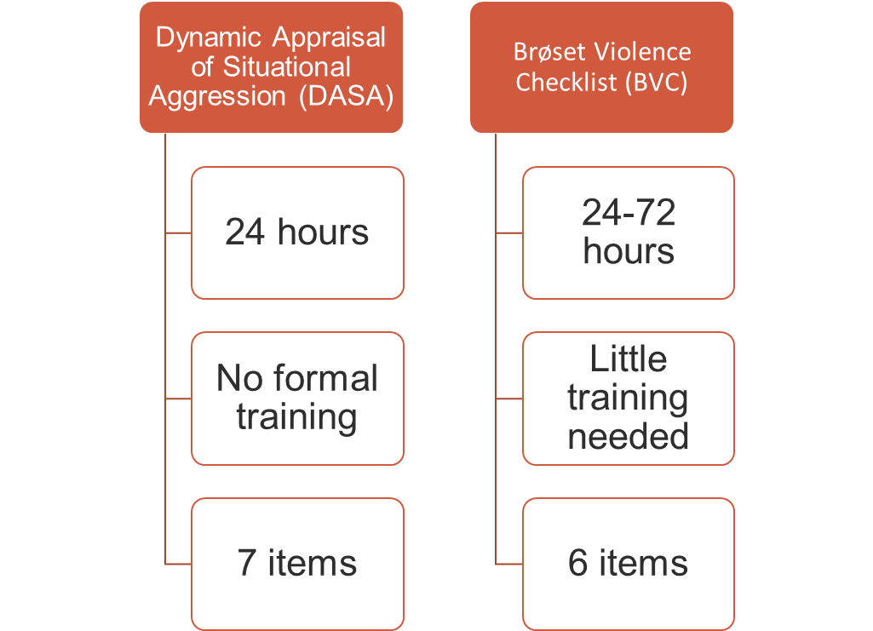

ED Appropriate

Slide 61
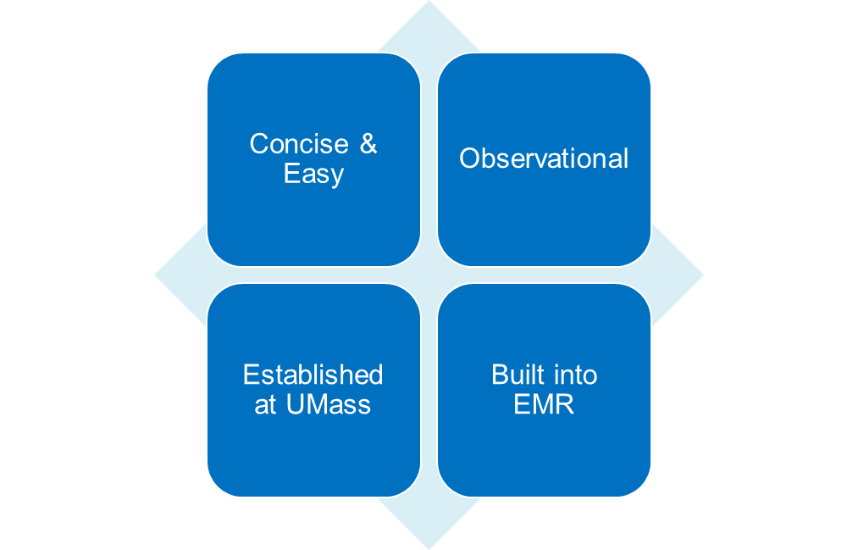
Why DASA?

Slide 62
Dynamic Appraisal of Situational Aggression (DASA)
Developed by Ogloff and Daffern in 2006 to assess the likelihood that a patient will become aggressive within 24 hours in an inpatient psychiatric unit.
Found to predict aggression significantly better than unaided clinical risk judgements by psychiatric nurses.

Slide 63
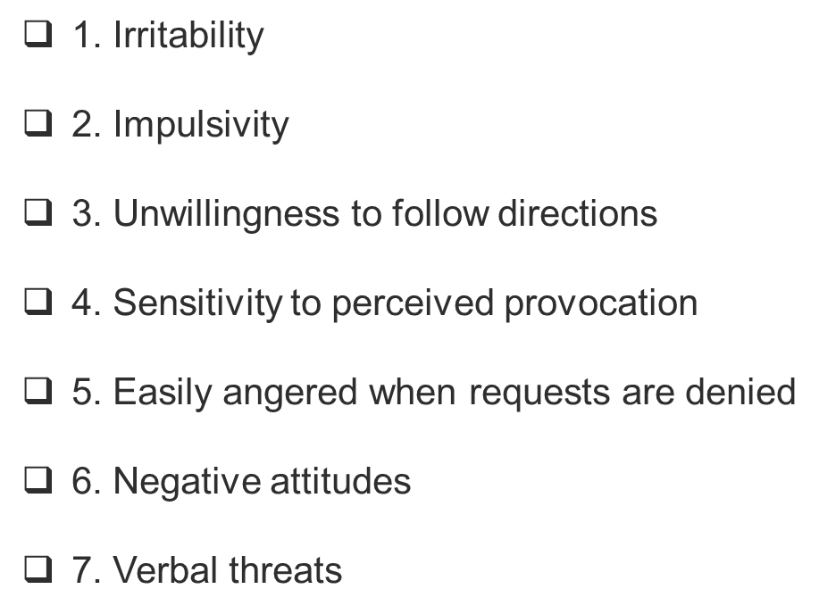
DASA
Seven simple items that are maximally effective at identifying patients at risk for engaging in inpatient violence within 24 hours.
The nurse assigns a score of 0 (absence of behavior) or 1 (presence of the behavior) for each item.
A score from each observation will be added together for a total score range of 0 – 7.

Slide 64
DASA Scores – Risk Levels
“As the goal of using the DASA is not just to predict risk for aggression but to help manage the risk, scores of 4 or more should be considered high enough to require immediate intervention aimed to reduce the likelihood of patients engaging in physical aggression.”
Score of 0 = Low risk
Scores of 1 - 3 = Moderate risk
Scores of 4 or 5= High risk
Scores of 6 or 7 = Imminent risk

Slide 65
Improve the safety of caregivers and patients
Early recognition of escalation
Reduce violent events and restraints
Reduce caregiver and patient harm events
Improve communication and awareness among staff
Create consistent, clear, and common language
Improve perception of hospital engagement
Quantify risk of aggression
Early intervention

Slide 66
Meet the Team
Physician Lead
Workplace Violence Program Manager
Senior Director, Emergency Preparedness, Safety, and Transportation
Vice President Patient Care Services
ED Physicians
ED Nurses
ED Nurse Managers
ED Medical Directors
Pediatric ED Nurses
Psychiatric Nurses
Nurse Educators
Risk Management
ED Informatics
EPIC support
Workplace Violence Committee Members
Security
Diversity, Equity, Inclusion Office
Legal Office
Senior Leadership

Slide 67
Scope of DASA Project
In:
All adult and pediatric patients ≥ age 5 in Memorial, University, Marlborough, Leominster, and Clinton Emergency Departments
Out:
Patients ≤ age 5, post-acute care areas such as inpatient, operating rooms, outpatient offices or ICU. Excludes Harrington emergency department campus.

Slide 68
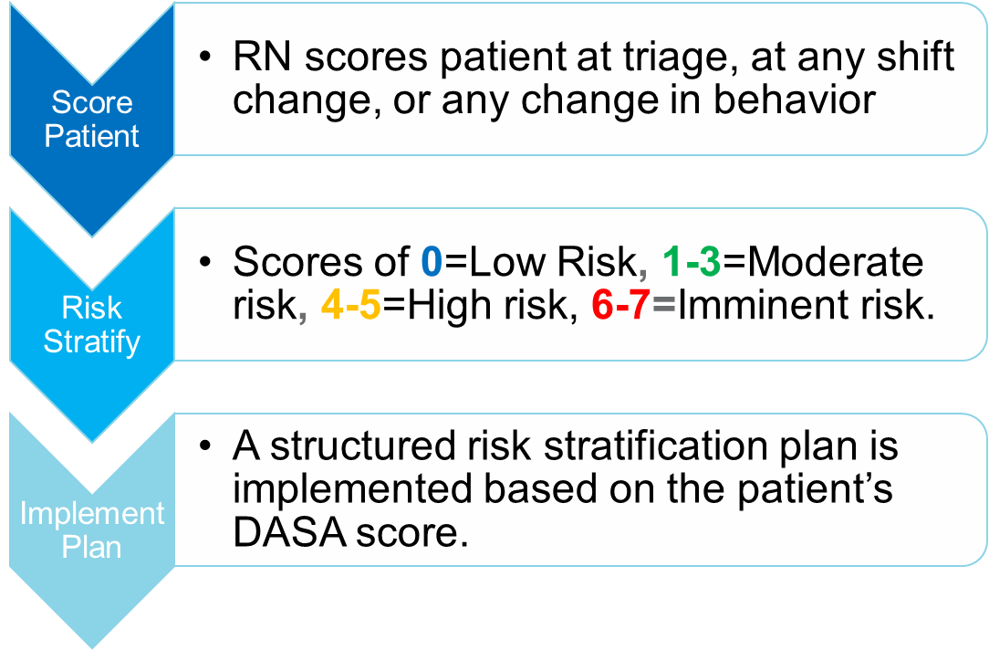
DASA ED Procedure

Slide 69
0 = LOW RISK of violence. No plan of care is required.
Reassess and rescore patient prior to next shift change
1-3 = MODERATE RISK of violence. Preventative measures should be taken. Initiate the following plan:
Communicate key risks to all members of the care team
Be aware of your body language, utilize an appropriate posture and stance (bladed stance, hands open and visible), and maintain a non-threatening approach

Slide 70
4-5 = HIGH RISK of violence. Initiate the following plan:
Utilize MODERATE RISK plan of care above, additionally:
Consider notifying attending or their designee, of patient with a high-risk level and consideration of prn medication orders***, psychiatric team involvement, or patient observer (If clinically appropriate)
Discuss a plan of care with the patient, where applicable. Assess what interventions are/were helpful when the patient is stressed and utilize appropriate de-escalation strategy techniques
Exercise caregiver safety: utilize awareness and vigilance with positioning while inside of the room. Maintain a reactionary gap between yourself and patient. Maintain the ability to quickly access an exit. Avoid entering the room/area alone.

Slide 71
6-7 = IMMINENT RISK of aggression. Initiate the following plan:
Utilize plans from MODERATE & HIGH-RISK scores listed above, additionally:
Notify attending physician or their designee, to communicate the patients current risk level and consideration of prn medication orders***.
If patient IS NOT located in a designated treatment area, Notify Flow RN/Pedi Resource of imminent-risk individual and discuss potential expedited bed placement, or EMH placement***.
Consider calling Police/Security if concern for physical danger to patient/staff.

Slide 72
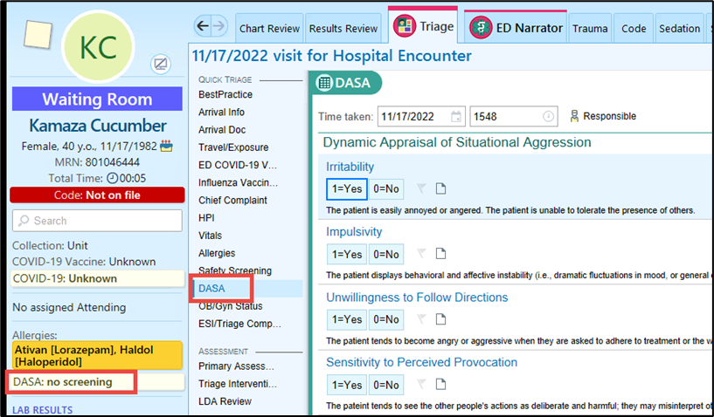
DASA in Triage

Slide 73
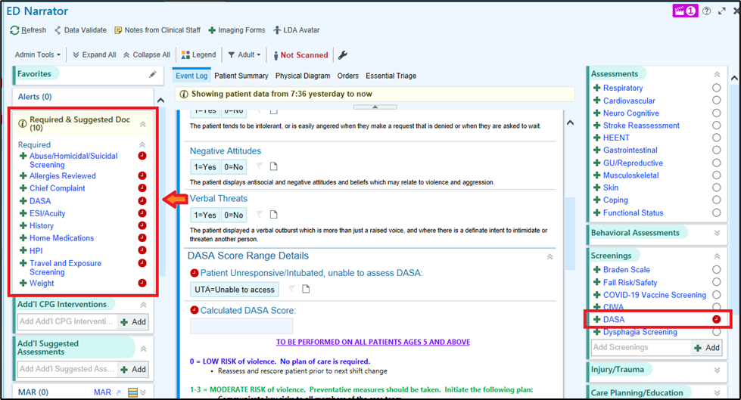
DASA in ED Narrator

Slide 74
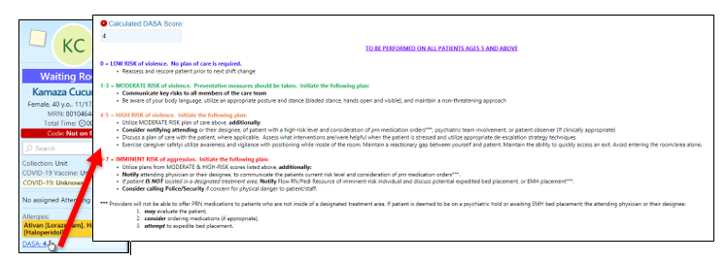

Slide 75
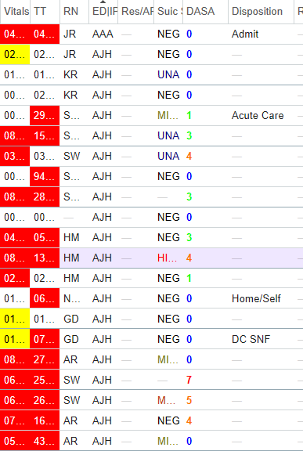
DASA Column on EPIC Track Board

Slide 76
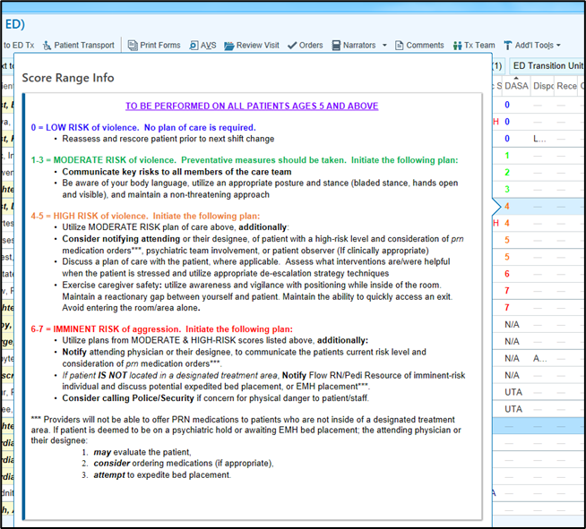

Slide 77
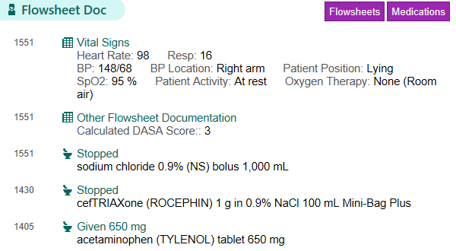
Physician View

Slide 78
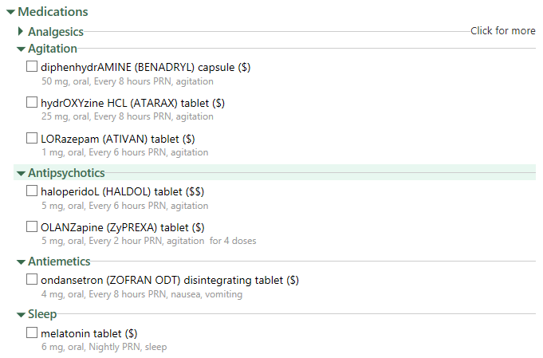
Physician Order Set

Slide 79
Go Live Jan 11, 2023
Flyers/Signage – Coming Soon with Go Live Date (January 11)
E-Learning Module for Nurses
Physician/APP education at faculty meeting
Resident education at resident conference
Huddles
Nurse Educator rounding
Laminated Cards and Posters
Performance Validation & Cases

Slide 80
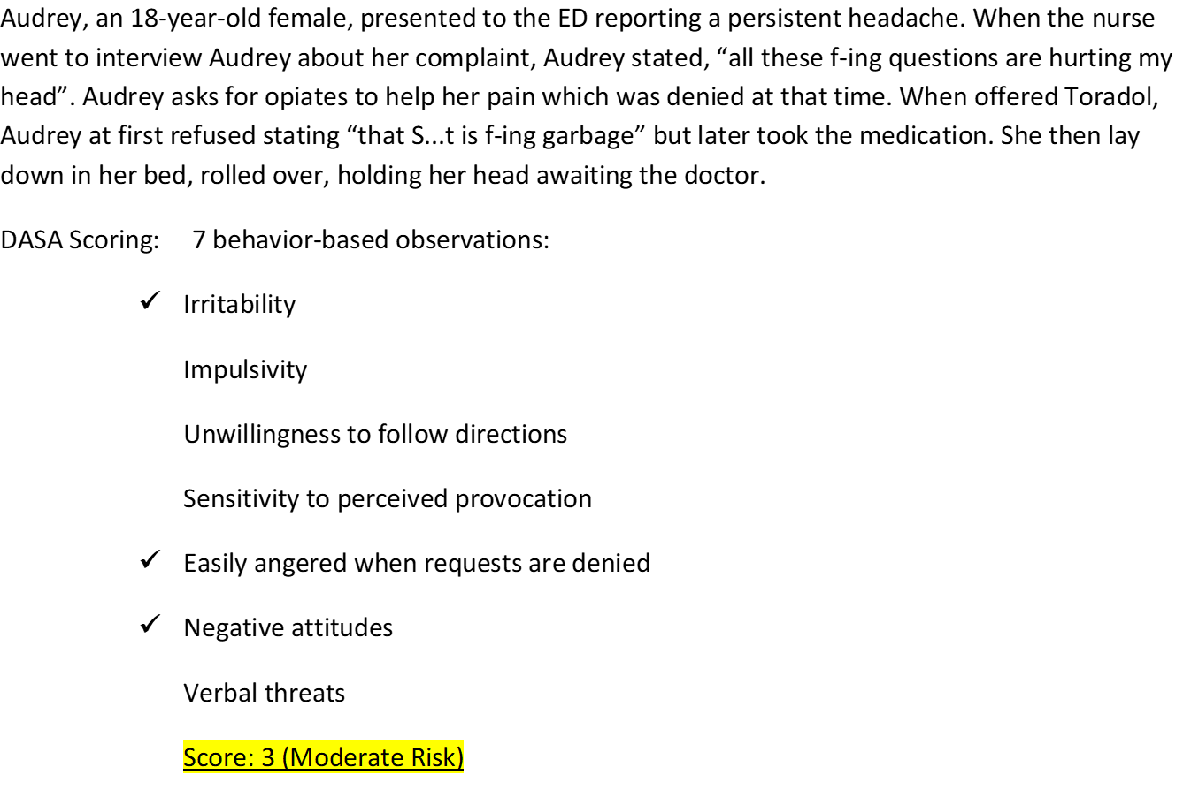

Slide 81
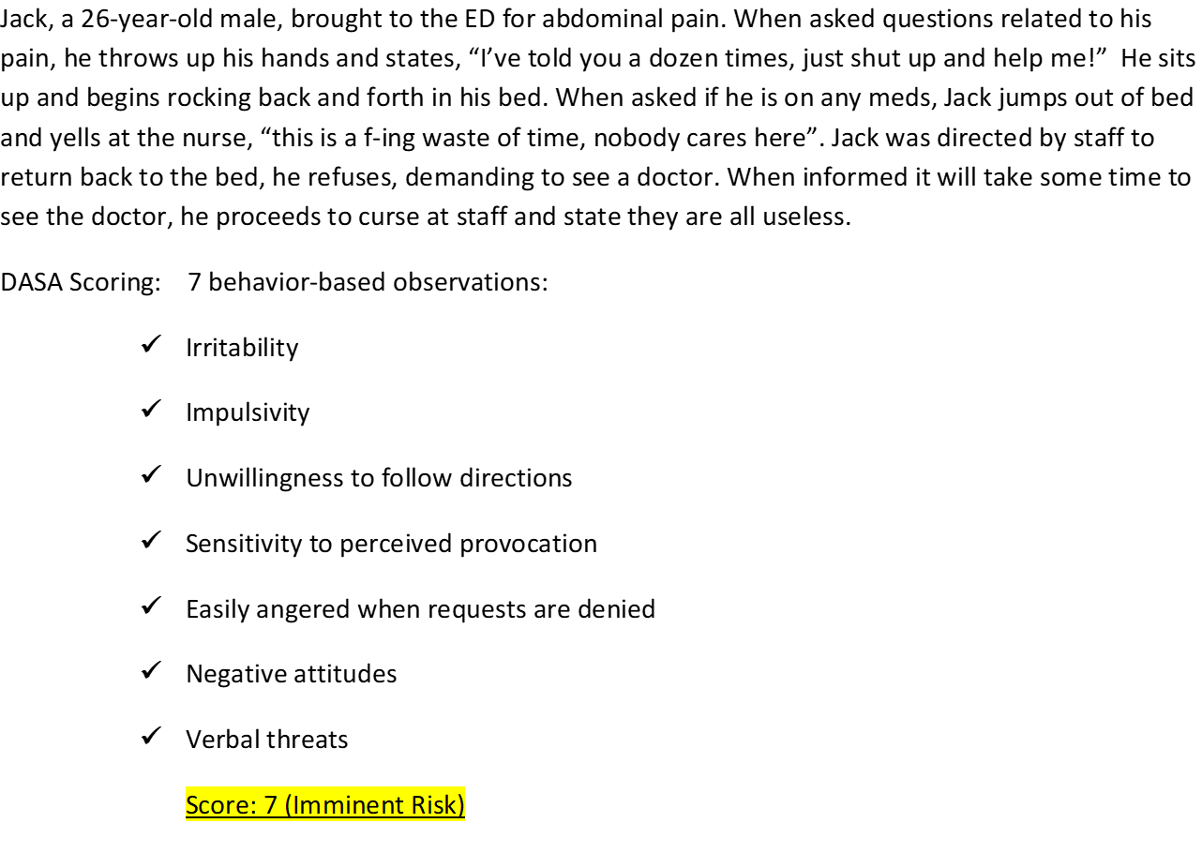

Slide 82
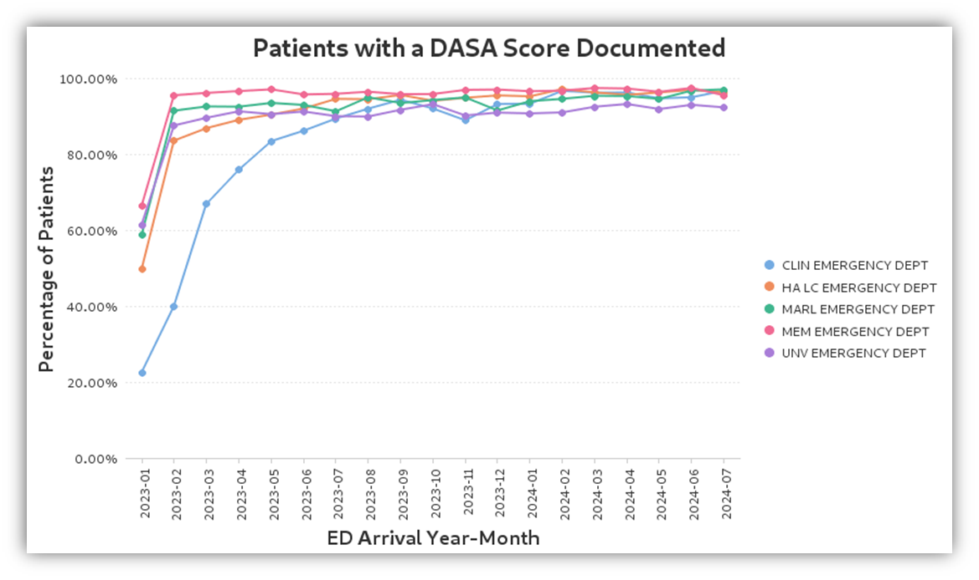

Slide 83
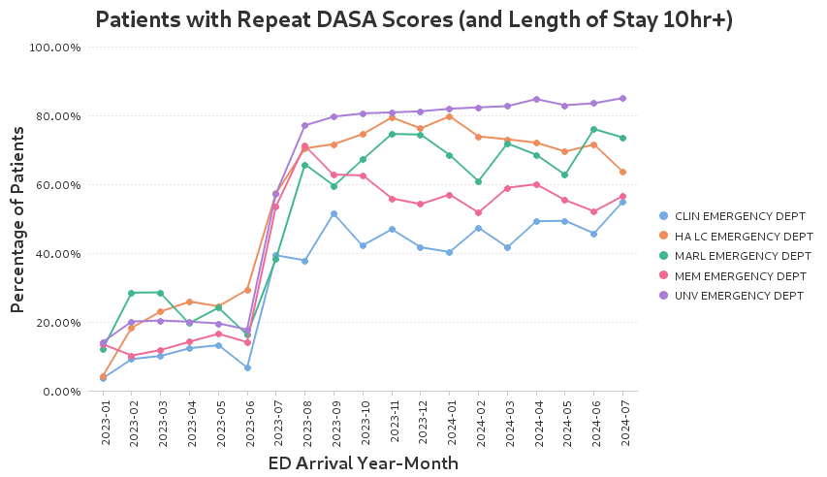
EPIC Alert

Slide 84

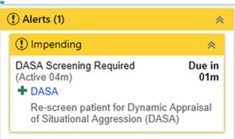
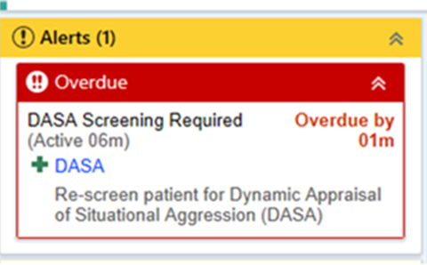

Continuous Improvement - Alert

Slide 85
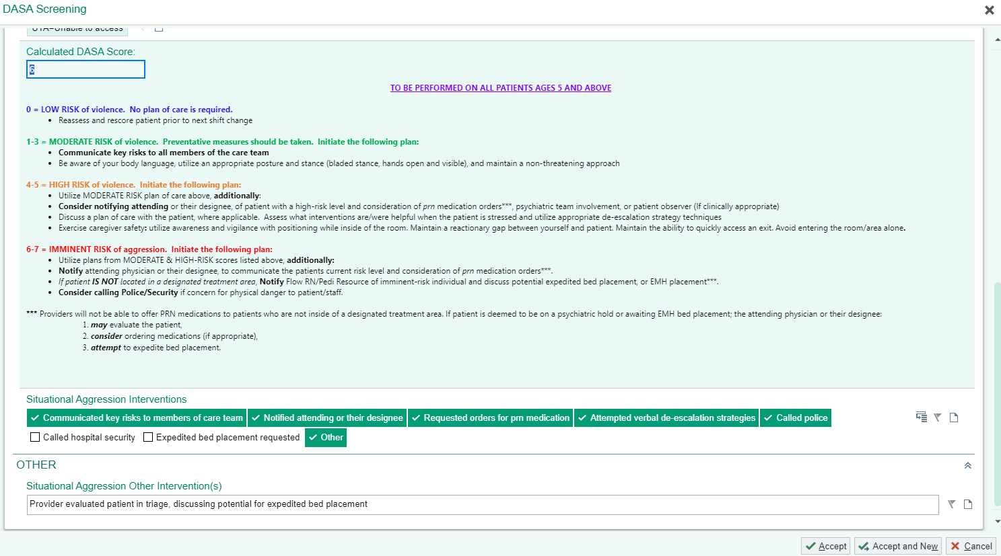
Continuous Improvement - Check Boxes
Communicated key risks to members of care team.
Notified attending or designee
Requested orders for prn medications
Attempted de-escalation
Called police/security
Expedited Bed
Other

Slide 86
January 11, 2023-December 31, 2023
192,947 adult encounters
159,154 had DASA score at triage (80.3%)
Male sex, younger age, higher acuity Emergency Severity Index (ESI), and arrival by police, ambulance, or aircraft were associated with higher risk DASA
Asians had lower risk of high DASA score
No other clinically significant difference in race or ethnicity

Slide 87
Were Particular Patients Not Scored?
No difference in age, race, sex assigned at birth, or ESI
Patients not assigned score had slightly lower median age and were interestingly more likely to be primarily English-speaking.

Slide 88
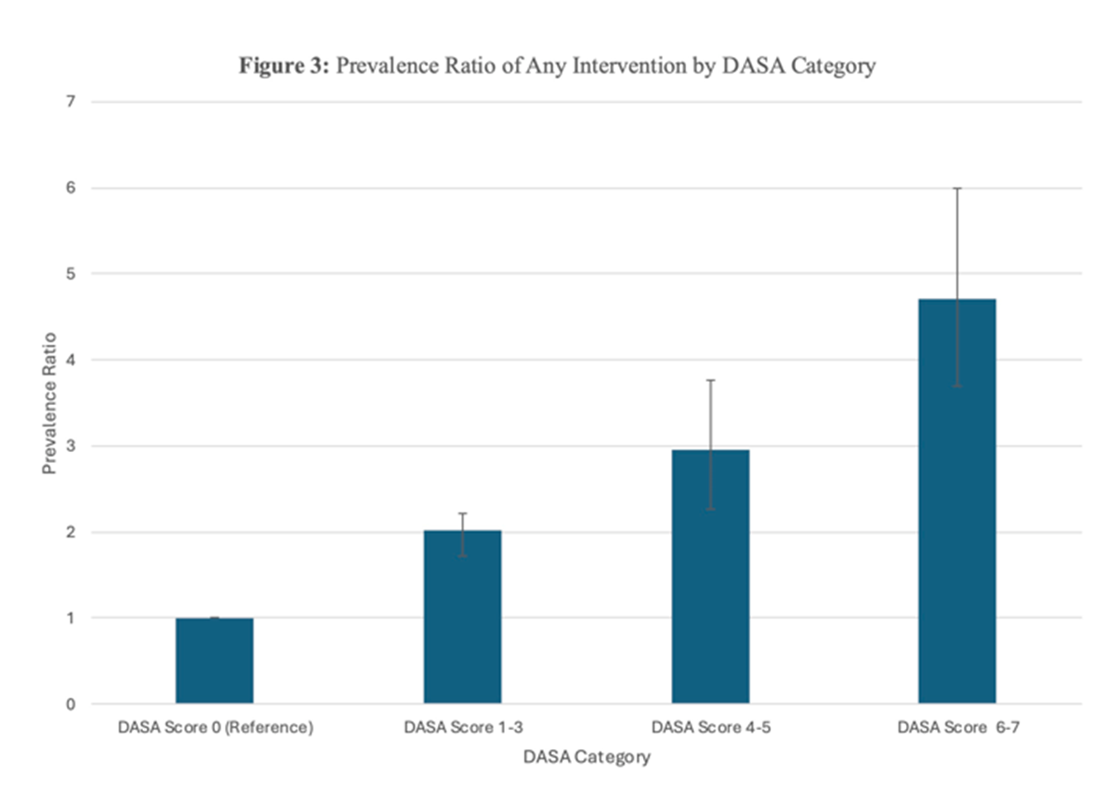
Prevalence Ratio of Restraint/Medication Intervention by Triage DASA Category
7
6
5
Prevalence Ratio
4
3
2
1
0 1-3 4-5 6-7
DASA Category

Slide 89
Preliminary Pediatric Data
Trends may be consistent in ages 12-17 but not below age 12.
Possibly related to developmental milestones

Slide 90
The Future of DASA
Follow data
Monitor bias and diversity
Continuous Improvement
Expand
Set a standard

Slide 91

DASA is just the first step.
Can you add more?

Slide 92

Thank you!
Amy Costigan: amy.costigan@umassmemorial.org
Janell Forget: Janell.forget@umassmemorial.org

Slide 93
References
Occupational Safety and Health Administration. Guidelines for Preventing Workplace Violence for Healthcare and Social Service Workers (OSHA, 3148-04R). Washington, DC: OSHA; 2015.
Omar H, Yue R, Amen AA, et al. 368 reassessment of violence against emergency physicians. Ann Emerg Med. 2018; 72(4 Suppl):S144.
Behnam M, Tollotson RD, Davis SM et al. Violence in the emergency department: a national survey of emergency medicine residents and attending physicians. J Emerg Med. 2011;40:565-579.
May DD, Grubbs LM. The extent, nature, and precipitating factors of nurse assault among three groups of registered nurses in a regional medical center. J Emerg Nurs. 2002;28:11-17.
Anderson, KK, Jenson CE. Violence risk-assessment screening tools for acute care mental health settings: Literature review. Archives of Psychiatric Nursing 22 (2019) 112-119.
American College of Emergency Physicians. Risk Assessment and Tools for Identifying Patients at High Risk for Violence and Self Harm in the ED. Nov 2015.
Ogloff, J. R. and Daffern, M. (2006), The dynamic appraisal of situational aggression: an instrument to assess risk for imminent aggression in psychiatric inpatients. Behav. Sci. Law, 24: 799-813.
Griffith J., Daffern, M., and Godber T., Examination of the predictive validity of the Dynamic Appraisal of Situational Aggression in two mental health units. International Journal of Mental Health Nursing (2013) 22, 485-492).

Slide 94
Please Note
This material was created for NNESHRM’s Conference.
Republication or reuse of the material without the permission of the primary speaker is prohibited.
Thank you.

Slide 95
Lessons Learned:
Coordination with Law Enforcement

Slide 96
Speakers:
John Duval, MBA
Director of Security, Concord Hospital Health System
Todd Hudson, MBA, CPHRM, CHC, CPPS, CPHQ, LSSGB, MLS(ASCP)^{cm}
Director of Enterprise Risk Management, Concord Hospital Health System
*No conflicts to disclose

Slide 97
Objectives:
Share strategies to enhance communication and collaboration between law enforcement agencies and healthcare facilities to maintain a safe environment.
Develop tools that will assist front line staff in interactions with law enforcement.
Discuss the commonly encountered law enforcement requests in the context of patient rights.

Slide 98
Overview:
Healthcare facilities frequently interact with various law enforcement entities.
This presentation will share how the relationship between a medium-sized health system has evolved over time with various Law Enforcement agencies.
Several notable case studies will demonstrate how opportunities for improvement were identified and what strategies have been implemented in a continuous effort to maintain a positive working relationship with these important community partners.

Slide 99
Law Enforcement Requests
Search Warrant Process
Handling of Contraband
Interviews: Patients & Employees
Security Camera Footage
Body Worn Cameras
Staff Testimony
Patient Updates (discharge information…)
Service of Legal Paperwork (IEA, subpoenas, court orders)
“Can you do me a favor?”
Notes:
Reminder: variability amongst law enforcement entities, hospitals, staff, shifts, etc. A law enforcement officer being told no may not be received w ell especially considering their role.

Slide 100
Custodial Patients
Prisoners, Inmates, Under Arrest…
  What is “custody”?
Which Agency?
  Post orders differ by agency
Patient Rights?
Law Enforcement Officer protocol?
Notes:
Define what custody means. Does not include someone on a bracelet or on bail.

Slide 101

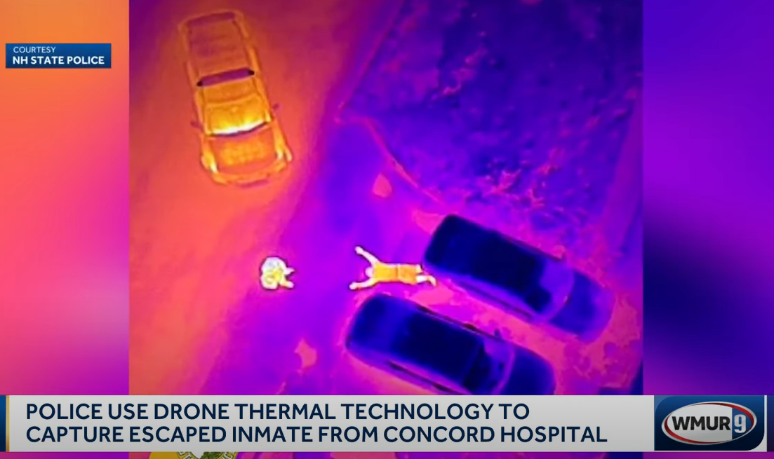
Patient/Inmate Escape

Slide 102
Background/Context
C4 upgraded to C5 Inmate
Multiple visits to ED in days preceding escape
Retained foreign bodies
Stalling tactics (consent/refusal of care)
Emergency Injunction and Restraining Order to Treat eventually granted
In contact with prison medical staff/leadership (not Warden)
Coordination of care between ED, ENT and GI lead to hospital admission

Slide 103
Debrief and Follow Up
Suspicious activity identified on security camera footage review
Meetings with Hospital and DOC Leadership
Information sharing: Post orders, policy/procedure
Communication pathways
Escalation mechanism
Enhanced Security staff rounding
  Statistics…
Notes:
Have up to date stats for examples

Slide 105
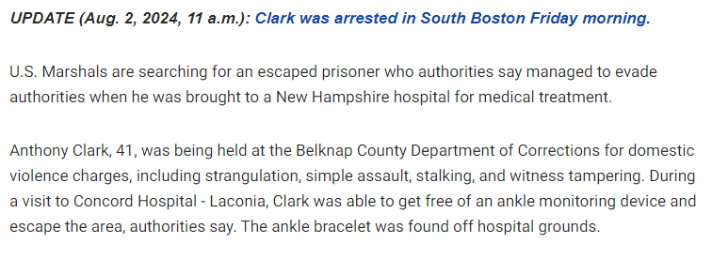
(Another) Escape* from Facility

Slide 106
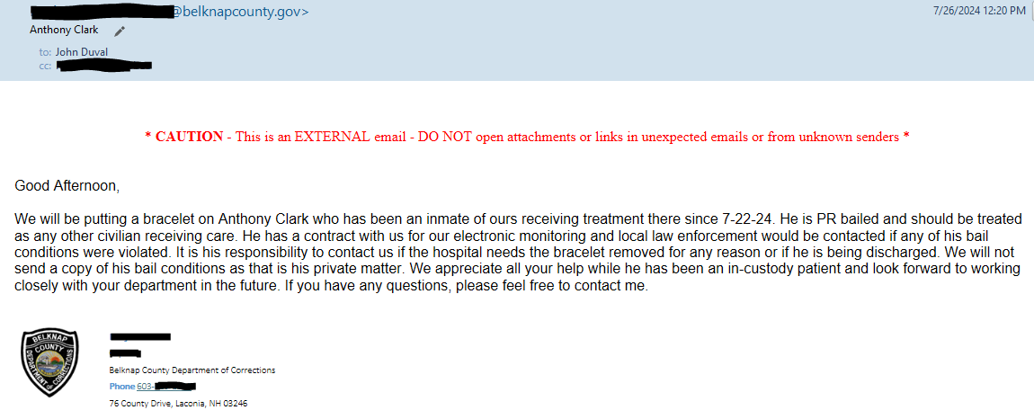

Slide 107
Debrief and Follow Up
Custodial transition to Non-custodial*
Clarification of Roles, communication expectations, patient rights

Slide 108

Evidence Collection

Slide 109
Debrief and Follow Up
Meeting with local PD (multiple), Sheriff, Prosecutor’s office
Information sharing
Coordination with Prosecutor Office on policy language and handling of contraband
Communication Pathways established
Notes:
Follow up meeting in October with Chiefs from across Merrimack County at Concord Hospital – Lunch provided!

Slide 110
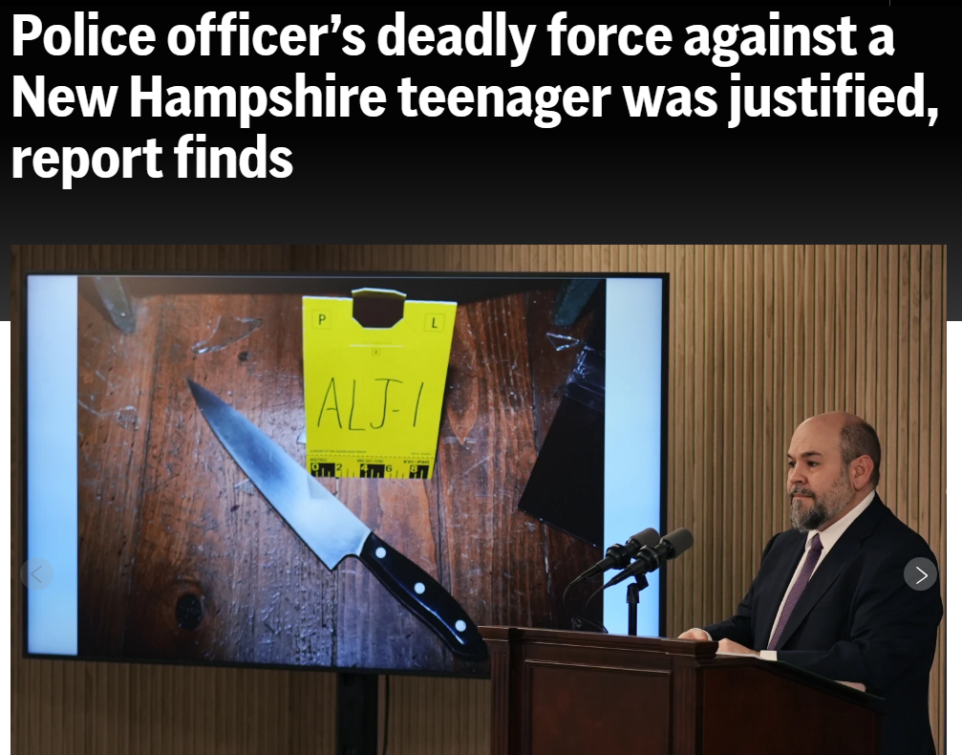
Active Investigation/Crime Scene

Slide 111
Debrief and Follow Up
Employee reaction at onset of arrival with victim and law enforcement presence and interactions
  Small community
Meeting with AG representative and hospital staff
Contact sharing
Workflow insight
Role clarity
Closure for staff

Slide 112
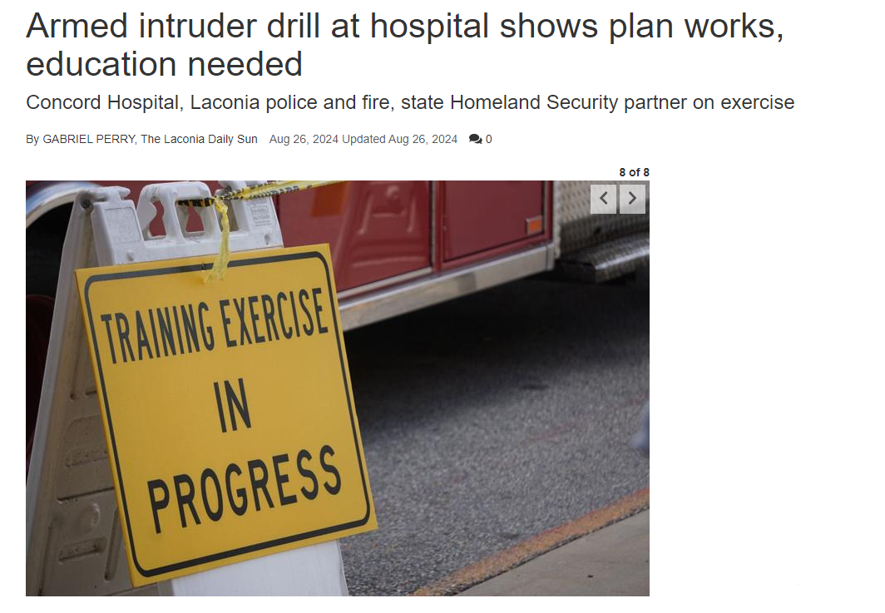
Response Drills
Notes:
Explain Armed Intruder vs. Active Shooter for context

Slide 113
Debrief and Follow Up
After Action Report – Hotwash
Community Awareness
Communication Tools evaluation

Slide 114
Takeaways
“Help us help you”
Policy sharing
Routine meetings
Conversations vs Emails
Consider resource constraints on all sides
Staff satisfaction

Slide 115
Next Steps
Maintain relations
Check-in with contacts
Consider including resources in policy development proactively

Slide 116
Thank You!
Questions?
Contact Info:
John Duval – joduval@crhc.org (603) 227-7000 x7089
Todd Hudson – thudson@crhc.org (603) 230-6150

Slide 117
Please Note
This material was created for NNESHRM’s Conference.
Republication or reuse of the material without the permission of the primary speaker is prohibited.
Thank you.

Slide 118
Please help yourself to lunch!

Slide 119
Thank you for being Diamond Level Sponsors!

Slide 120
Thank you for being a Platinum Level Sponsor!

Slide 121
Thank you for being Gold Level Sponsors!

Slide 122
Thank you for being Silver Level Sponsors!

Slide 123
36th Annual Report
November 18, 2024
Hybrid
Haraseeket Inn Freeport ME

Slide 124
Member Recognition
New Members
CPHRM
FASHRM
DFASHRM
ASHRM Committees
Notes:
Use Chat

Slide 125


ASHRM Affiliation
NNESHRM remains an Affiliated Chapter of ASHRM
We receive a Chapter Rebate for each NNESHRM member who also belongs to ASHRM

Slide 126
NNESHRM Board 2024
President- Todd Hudson NH
Past-President- Alicia LaRoche ME
President-Elect- Janet Maguire ME
Secretary- Jennifer Hannux VT
Treasurer-Michelle Boucher ME
At Large- Alison Eastman VT
At Large-Joey Mattson NH
At Large- Dave Herzer ME
At Large- Janet Maguire ME
Treasurer-Elect- Nicole Thayer ME

Slide 127
2023-2025 Strategic Plan Update
The 2023-2025 Strategic Plan will focus on 3 Grand Strategies:
Stability —Membership support is essential for NNESHRM to expand services. As a volunteer position, it is crucial to reduce the administrative burden while increasing member engagement to encourage participation.
Growth — NNESHRM must maintain a stable membership rate and encourage renewals while cultivating new members, including those from other disciplines.
Product Development — Product development is essential to attracting and maintaining members. Without additional services, the value of membership is reduced, thus decreasing the incidence of membership loss.

Slide 128
2023-2025 Strategic Plan
Stability
1.1 Long-term objective: Members will be fully engaged in support of all committees & activities of NNESHRM.
Goal: 50% of Committees will be chaired by members; and non-Board members will comprise at least 50% of any committee/activity.
1.2 Long-term objective: NNESHRM will retain 50% of sponsors and increase sponsorship dollars to:
Goal: $5000 CY 2023; $6000 CY 2024; $7500 CY 2025
Growth
2.1 Long-term objective: NNESHRM will retain 85% of current members while increasing new members by 20% by year-end 2025.
Goal = 133 members by 2025
Product Development
3.1 Long-term objective: NNESHRM will develop one (1) sustainable program or service each year.
Goal: 1 in CY 2023; 2 in CY 2024; 3 in CY 2025
3.2 Long-term objective: NNESHRM will increase our opportunities to provide more CEUs.
Goal: 12 in CY 2023;13 in CY 2024; 14 in CY 2025
3.3 Long-term objective: NNESHRM members will be actively involved in at least one (1) State initiative that affects the healthcare sector by year-end 2025.

Slide 129
2024 Committee Reports
Regional - Todd Hudson
Bylaws – Alicia LaRoche
Nominating – Alicia LaRoche
Communication – Kerri Armani
Education – Janet Maguire
Finance – Nicole Thayer
Membership – Frank Korn
Subsidization – Jennifer Hannux
Sponsorship – Nicole Thayer

Slide 130
2024 Regional Conference Update
1st Conference as NERC Three chapters have established a New England Regional Committee (NERC) to oversee the conference
NERC: Chair, Vice Chair, and the President and President-Elect of each chapter (MA, CT, NNE)
  Each subcommittee will have Chair & Vice Chair for succession planning, more consistency, and less work/rework.
2025 Regional Conference – Portland, Maine May 4-6

Slide 131
Bylaws Committee
No changes to NNESHRM Bylaws proposed in 2024

Slide 132
Nominating

Slide 133
Nominating Committee
Members
Jennifer Hannux
Alicia LaRoche
Goal: Timely nomination & ballot process.
Open 2024 positions:
  President-elect
  Member at Large (2)
Results - Congratulations
  President-elect- Joey Mattson
  Member at Large – Jennifer Hannux
  Member at Large – Kerri Aramini
Thank you all for you willingness to serve NNESHRM members and your participation!

Slide 134
Communication Committee
2024 Annual Report

Slide 135

Thank you
Communication Committee Members!
Members
Kerri Aramini - Chair
John Ramon
Aimee Costello
Maria Martin
Diana Alessandrini
Activities to Date
Enhanced social media presence – LinkedIn page
Content Calendar
Committee Activity Binder for operational continuity

Slide 136
Communications Committee Report
Support NNESHRM’s 2023-2025 Strategic Plan
Long term goals: 1.1 Stability and 2.1 Growth
Short-term objective:
Utilize social media platforms to support marketing, recruitment, and retention strategies.
Utilizing data analytics to bolster marketing, recruitment, and retention efforts
Developing processes for advertising using social media

Slide 137
Communications Committee Report Cont.’
Support NNESHRM’s 2023-2025 Strategic Plan
Long term goals: 1.1 Stability and 2.1 Growth
Short-term objective:
Standardize process for marketing and recruitment.
Developing a marketing plan
Created marketing documents which outline the benefits of NNESHRM membership and “dual” membership: local and national. Include the upcoming changes – new offerings for members
  Submit for Board approval: Due—11/2023
Implement
  marketing document: Due—1/2024
  Implement marketing using Social Media platforms: Due—6/2024

Slide 138
Communications Committee Report Cont.’
Support NNESHRM’s 2023-2025 Strategic Plan
Long term goals: 1.1 Stability and 2.1 Growth
Short-term objective:
Foster engagement by providing timely and accurate information to members.
Provide overview of committee duties and time commitment during the annual report (see next slide ☺)

Slide 139
Join us on the Communications Committee!
NNESHRM Communications Committee
Sponsorship
Regularly review and optimize website content
Oversee the organization's website, ensuring it's up-to-date and user-friendly.
Social Media Management
Maintain and update social media accounts.
Monitor online conversations related to the organization.
Web Maintenance
Maintain website
Assist with communication
Branding and Visual Identity
Create Marketing materials
Ensure consistent branding and visual identity across all communication materials.
Approve and manage the use of the organization's logo and branding elements.
Public Relations for Outreach
Regional Committee
ASHRM
Want to learn about or help us with…?

Slide 140
Education Committee
2024 Annual Report

Slide 141
2024 Education Committee Members
Education Committee
Janet Maguire – Co-chair
Beth Dodge
Jennifer Hannux
Nicole Thayer
Joey Mattson
Aimee Dodge
Laura Yorke
Todd Hudson – Co-Chair
Steve Fiore
Jim Gregoire
Darcy Gray
Christopher McGown
Alicia LaRoche

Slide 142
Update on 2024 and Looking Ahead
2024
Spring and Fall Hybrid Education Days – 11 CEUs combined and a total of 91 attendees
Regional Conference Collaboration
Maine SET – Second Victim 1 Day Conference
2025
Continue to offer our two hybrid education days
Continued Regional Conference collaboration (in Portland 2025)
Look to increase CEU opportunities
State Initiatives
Offer Round Table Discussions

Slide 143
Finance and Sponsorship Committee
2024 Annual Report

Slide 144
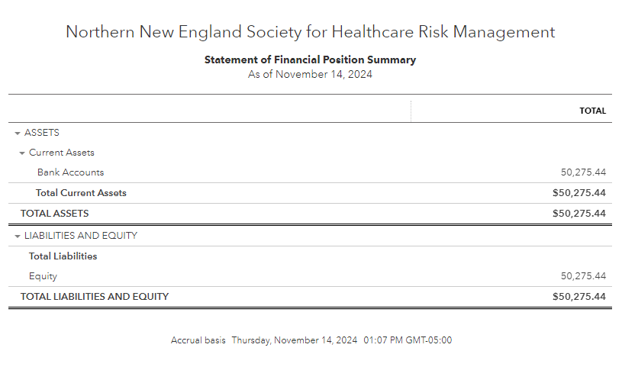
Treasurer’s Report – 2024
Net Worth as of 11/14/2024

Slide 145
Sponsorship Committee
Sponsorship Program
  Goal: $6000 for 2024
  Year Four – We exceed our goal for 2024!
  Total sponsorship: over $17,000
Special thanks for their work on sponsorship!
  Dave Herzer
  Frank Korn

Slide 146
Membership Committee
2024 Annual Report

Slide 147
Membership Committee
Committee Members
Frank Korn, Chair
Janelle Forget

Slide 148
Membership Report - Membership Status
As of November 2023- 125 active members
2024 goal: Identify opportunities to increase membership & value
Expand Mentee / Mentorship Program

Slide 149
Membership Report - 2024 Activities
Mentor Program (2024)
  Mentee – 0 application
  Mentor – 1 applications
Program Discussion
2025 Dues
  Membership dues for 2025 increasing to $100
  Difficult decision in response to rising costs associated with educational offerings
  A reminder will go out by the end of November.
  Still a great value!
Notes:
Each of these items were directly asked for by membership in 2019 survey

Slide 150
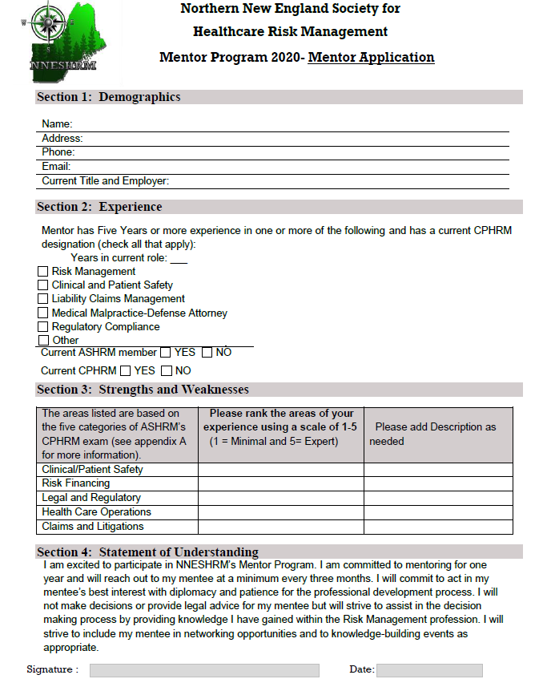
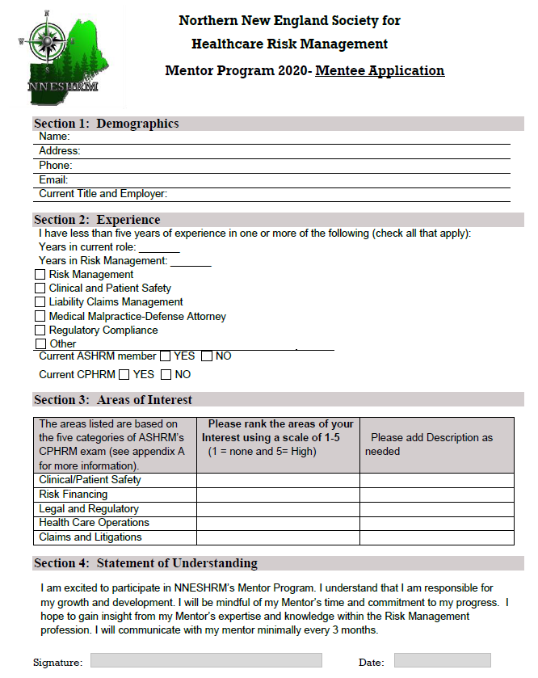
Membership Report - Mentor Program
Purpose: Pair experienced and trusted advisors with new risk management professionals.
Mentors ≥ 5 years experience; Mentees ≤ 5 years
Applications are available on the website.
Completed applications emailed to membership@nneshrm.org
Applications will be reviewed at each membership committee meeting. Contact will be by and through the committee chair.
Loose structure with goal setting and minimum frequency of meetings (quarterly)

Slide 151
Membership Report - 2024 Plan and Priorities
Continue to Grow membership and value
Expand Mentor Program
Collaborate with State Hospital Associations
Target new roles & services for potential membership
Roundtables – informal virtual meetings for open collaboration and discussion on pressing topics, specifically requested topics, state-specific topics, etc.
Expand Membership Opportunities beyond education days
  Dinner/Topic Networking Events

Slide 152
Subsidization Committee
Subsidization Practice:
  Subsidization requests are reviewed by the board at the following monthly board meeting after they are received.
  Requests are approved by vote at the discretion of the board based on the details of the request, member engagement, and the financial feasibility of the Chapter to support such a request at any given time.
  2024 – one request received, reviewed, and approved for attendance at the Spring Education Day

Slide 153




Acceptance of Committee Reports
NNESHRM Membership

Slide 154
Recognition of Outgoing Board Members
Alicia LaRoche – Past President
Michelle Boucher - Treasurer
Dave Herzer - Board Member at Large

Slide 155
NNESHRM Board 2025
President - Janet Maguire ME
Past-President - Todd Hudson NH
President-Elect - Joey Matteson NH
Secretary - Sherryann St Pierre ME
Treasurer - Nicole Thayer ME
At Large - Alison Eastman VT
At Large - Kerri Aramini NH
At Large - Jennifer Hannux VT
At Large - Frank Korn NH

Slide 156
Paulette Gagnon Award

Slide 157
2024 Paulette L. Gagnon Award
1995 - Paulette L. Gagnon
1996 - Nancy R. Hacking
1997 - Geraldine Amori
1998 - Barbara M. Maloney
1999 - Patrick McGrath
2000 - Kathleen MacKinnon
2001 - Lori Chabot
2002 - Linda McElhinney
2003 - Barbara Dotson
2004 - Patrick McGrath
2005 - Ann Turbyne
2006 - Pamela Haughawout
2007 - Barbara Richards
2008 - Nancy Fredholm
2009 - Jay Purcell
2010 - Bonnie Ellis
2011 - Julie Phelan
2012 - Sue Boisvert
2013 - Kelly Ahearn
2014 - Lou Anne McLeod
2015 - Erin Graydon-Baker
2016 - Tatum O’Sullivan
2017 - Susan Montiel
2018 - Cheryl Peaslee
2019 - Lisa Simms
2020 - William Zuber
2021 - Beth Dodge
2022 – Amie Costello
2023 – Jeff Parsons
2024 – drumroll…
The Paulette L. Gagnon award is NNESHRM’s highest honor and goes to a chapter member who has distinguished themselves in promoting and supporting the chapter, the profession of risk management as a whole, and in the development of other risk professionals across the healthcare continuum.

Slide 158

2024 Recipient of the
Paulette L. Gagnon Award
Congratulations

Slide 159
Looking Forward to an Exciting 2025
Thank you to all of our members for your continued support and engagement
There are many opportunities to get more involved with the chapter, fresh ideas are always welcome
Thank you to those members that have served in the past, we wouldn’t be here without you!

Slide 160
Processing Legal Process
A Practical Guide to Responding to Subpoenas
and Medical Record Requests
Joseph G. Mattson, Esq.
Nicole J. Schultz-Price, Esq.
DEVINE, MILLIMET & BRANCH, PA

Slide 161

OBJECTIVES
Understand legal process and your rights in responding to it.
Understand how to balance the rights of patients with the rights and needs of the non-patient requesting medical information.
Understand how best to respond to protect you and the patient, while minimizing interruptions to patient care.

Slide 162

But first—
THE INHERENT CONFLICT

Slide 163
“Values that exist in tension with each other, not in harmony.”¹
It is an “ancient proposition of law…that the public has a right to every man’s evidence.” United States v. Nixon, 418 U.S. 683, 709 (U.S. 1974).
“Unless the patient waives the privilege…a person authorized to practice medicine…shall not be allowed to disclose any information.” 12 V.S.A. sec 1612.

Slide 164

Types of Process Relative to Record Release
Subpoena: A subpoena is a formal process by which a party involved in litigation can compel testimony from a witness or the production of specific documents, medical records, books, papers, or other items relevant to the matter at issue.
Warrant: A warrant is a document that authorizes a specific action, such as an arrest, search, or seizure. Warrants are usually issued by a judge or magistrate and are directed to a police officer, constable, or sheriff.
Discovery Requests: In a lawsuit, this is how the parties obtain information. For example, in a medical injury lawsuit interrogatories and requests for production of documents are propounded in connection with medical record authorizations.

Slide 165
Subpoenas
Two Types of Subpoenas
  Testimonial Subpoena: This commands a person to appear at a certain time and place to provide testimony, either in court or at a deposition.
  Subpoena duces tecum: A subpoena duces tecum (Latin for "bring with under penalty of punishment") is a type of subpoena compelling the production of specific medical records, books, articles, or other tangible things by a specific date.
  It is standard procedure for a subpoena duces tecum to state that the records custodian is to appear at a certain time and place with records in hand to complete a records deposition.
  When your intent is to simply respond to a subpoena by mailing the records, notify the attorney's office in advance of the deposition date so that they do not expect your personal appearance.

Slide 166

Remember --
Both types of subpoenas are a formal command that should never be ignored.
Failure to comply with the terms of a properly issued subpoena may result in a contempt-of-court citation and monetary fines, imprisonment, or other sanctions.
It is important that you timely respond to any subpoena.
Even if the subpoena is facially invalid, ignoring the process is risky. (Joey tried this once and did win…eventually).
A healthcare organization that responds inappropriately may violate HIPAA or state privacy regulations and be severely penalized.

Slide 167
But what should you do when you receive a subpoena?

Slide 168
Follow Three Critical Steps when Responding to a Subpoena for Medical Records while Protecting Patient Privacy and Confidentiality

Slide 169
Step 1: Determine who issued the subpoena.
Judge: If the subpoena is signed by a judge or magistrate, the request must be honored and health information must be provided, although it is possible to object by writing to the court specifying the grounds for objection.
Attorney: If a valid subpoena is signed by an attorney or a court clerk, HIPAA permits the disclosure of medical records if one of the following conditions is met:

Slide 170

1. A written statement and accompanying documentation are received from the person issuing the subpoena demonstrating a good faith attempt was made to provide written notice of the subpoena to the patient or his or her legal representative; the notice included sufficient information to inform the patient that they have the right to object to the subpoena; the time for objecting the subpoena has passed and the patient did not object to the subpoena or an objection was satisfactorily resolved by the court.

Slide 171

A written statement and accompanying documentation are received from the person issuing the subpoena demonstrating all parties to the lawsuit have agreed to a qualified protective order to maintain the confidentiality of the supplied information or that such an order has been requested. The qualified protective order limits the use of the information solely to the lawsuit and requires all information to be destroyed or returned when the lawsuit ends.

Slide 172

The covered entity makes reasonable efforts to notify the patient, stating a response is required by law, and the patient is informed of his/her right to object to the disclosure of their PHI and the patient fails to notify the covered entity that the subpoena has been set aside before the deadline for responding. The covered entity can also object to the subpoena.
A valid HIPAA authorization is obtained from the patient authorizing the covered entity to release his/her medical records and comply with the subpoena. In such cases, the information disclosed must still be limited to the information specifically requested in the subpoena.
Details of these requirements can be found in Title 45 of the Code of Federal Regulations, sections 164.512(c)(1)(ii); (e)(1)(iii)-(vi).

Slide 173

It is important to note that if none of the conditions is satisfied, PHI cannot be provided and a court order is required, BUT the subpoena cannot be ignored!
An objection should be made on the grounds of:
It does not allow reasonable time for compliance;
It requires disclosure of privileged or protected matter and there is no applicable exception or waiver;
It imposes an undue burden on the party subpoenaed;
It is unreasonable or oppressive; or
It is procedurally defective.

Slide 174
Step 2: Determine What is Being Requested
Review the information being requested.
Disclose only the minimum necessary.
You must only give the protected health information expressly authorized. 45 CFR 164.512.
A subpoena does not mean everything gets produced!
Double check state law—HIPAA is a floor, not a ceiling!

Slide 175

Step 3: Keep Track of Deadlines
Monitor deadlines—do not subject yourself to sanctions!
Allow yourself time to seek court approval or patient input.
HIPAA requires accessions be tracked, so it is good compliance.

Slide 176
Byrne v. Avery Center for Obstetrics and Gynecology, P.C., 2014 WL 5507439 (Conn. Nov. 11, 2014)
As the number of data breaches and federal and state enforcement actions for privacy and security violations reach new heights, Connecticut's highest court has added fuel to the fire in a decision that paves the way for individuals to use Health Information Portability and Accountability Act (HIPAA) violations as a basis for state negligence claims.
HIPAA does not provide a private right of action for violations. Only the federal or state government can seek sanctions, including fines, for HIPAA noncompliance. The absence of a private right of action under HIPAA has largely impeded private lawsuits that cite HIPAA violations as the basis for a negligence claim. Yet, the Connecticut Supreme Court ruled that a plaintiff may use HIPAA to establish the standard of care in negligence cases.
Byrne was a patient of the Avery Center for Obstetrics and Gynecology, P.C. The putative father of Byrne's child served the Avery Center with a subpoena for Byrne's medical records in connection with a paternity action filed against Byrne. The Avery Center mailed a copy of Byrne's records to the court without filing a motion to quash the subpoena, appearing in court, or notifying Byrne. The father accessed Byrne's medical records in the court file. Byrne sued the Avery Center for failure to use reasonable care in protecting her medical information, including disclosing it in violation of HIPAA.

Slide 177
Payne v. Taslimi, No. 18-7030, 2021 U.S. App. LEXIS 15972 (4th Cir. May 27, 2021).
In Payne v. Taslimi, the Fourth Circuit Court of Appeals ruled that a prisoner did not have a private right of action under HIPAA to sue for the improper disclosure of his HIV status:
There is no private cause of action to address an improper disclosure of medical information under the Health Insurance Portability and Accountability Act of 1996 (HIPAA), the U.S. Court of Appeals for the Fourth Circuit has held for the first time. The Court further precluded a cause of action based on a “right of privacy” theory under the 14th Amendment, but only because the plaintiff — a prisoner with limited rights of privacy — was unable to show he had a reasonable expectation of privacy to his medical diagnoses.
Although this case unfolded in a prison setting, this ruling could have implications in the workforce and reminds employers to treat confidential medical information of its workers carefully.

Slide 178
What “satisfactory assurances” must a covered entity that is not a party to the litigation receive before it may respond to a subpoena without a court order?
Under 45 CFR 164.512(e)(1)(ii) of the Privacy Rule, a covered entity that is not a party to the litigation may disclose PHI in response to a subpoena, discovery request, or other lawful process if the entity receives certain satisfactory assurances from the party seeking the information.
The entity must receive a written statement and accompanying documentation that the requestor has made reasonable efforts either
  to ensure that the individual(s) who are the subject of the information have been given sufficient notice of the request, or
  to secure a qualified protective order. (Alternatively, the covered entity may make such disclosures if it itself makes reasonable efforts to notify the individual(s) or seek a qualified protective order.) If the conditions above have been met, a court order is not required to make the disclosure.

Slide 179

Medical Record Requests
HIPAA covered entities (health plans and most health care providers) must provide individuals, upon request, with access to the protected health information (PHI) about them in one or more "designated record sets" maintained by or for the covered entity.

Slide 180
Information Included in the Right of Access:
The "Designated Record Set"
Individuals have a right to access PHI in a "designated record set." A "designated record set" is defined at 45 CFR 164.501 as a group of records maintained by or for a covered entity that comprises the:
Medical records and billing records about individuals maintained by or for a covered health care provider;
Enrollment, payment, claims adjudication, and case or medical management record systems maintained by or for a health plan; or
Other records that are used, in whole or in part, by or for the covered entity to make decisions about individuals. This last category includes records that are used to make decisions about any individuals, whether or not the records have been used to make a decision about the particular individual requesting access.
The term "record" means any item, collection, or grouping of information that includes PHI and is maintained, collected, used, or disseminated by or for a covered entity.

Slide 181

Information Excluded from the Right of Access
An individual does not have a right to access PHI that is not part of a designated record set because the information is not used to make decisions about individuals.
This may include certain quality assessment or improvement records, patient safety activity records, or business planning, development, and management records that are used for business decisions more generally rather than to make decisions about individuals.

Slide 182

Timeliness in Providing Access
In providing access to the individual, a covered entity must provide access to the PHI requested, in whole, or in part no later than 30 calendar days from receiving the individual's request. See 45 CFR 164.524 (b)(2).
The 30 calendar days is an outer limit, and covered entities are encouraged to respond as soon as possible.

Slide 183

HIPAA Balancing Test
HIPAA Privacy Rule aims to balance the need to protect patient privacy with the need to share health information for the public's health and high-quality care.
HIPAA includes a number of rules and guidelines that address how and when to disclose protected health information (PHI), including:
Minimum necessary: Covered entities must only use, disclose, or request the minimum amount of PHI needed to accomplish the intended purpose.
Low probability of compromise: A covered entity must demonstrate a "low probability" that PHI has been compromised to avoid being presumed to have breached HIPAA.
Physicians can use a four-factor test to assess the likelihood of compromise:
The type and amount of PHI involved
The identity of the person who used or received the PHI
Whether the PHI was actually viewed or acquired
The extent to which the risk to the PHI has been reduced
Disclosures for law enforcement: Covered entities can disclose PHI for law enforcement purposes in certain circumstances, including to comply with a court order or subpoena, or to respond to a request for identifying a suspect.
Disclosures for healthcare operations: Covered entities can disclose PHI without prior consent for healthcare operations, treatment, and payment. This includes consultations between providers, referring patients, and information required by law.

Slide 184
How do States Balance Privileged Information with the Need of Others to Know it?
Maine
New Hampshire
Vermont

Slide 185

QUESTIONS?

Slide 186
Please Note
Materials were created for NNESHRM’s Conference.
Republication or reuse of the materials without the permission of the primary speaker is prohibited.
Thank you.

Slide 187
Brief Break
Back in 15 minutes

Slide 188
Thank you for being Diamond Level Sponsors!

Slide 189
Thank you for being a Platinum Level Sponsor!

Slide 190
Thank you for being Gold Level Sponsors!

Slide 191
Thank you for being Silver Level Sponsors!

Slide 192
Panel Discussion: Risks, Benefits, and Realities of Remote and Hybrid Risk Management
Moderated by Jennifer Hannux
Panel: Susan Levenseler, Frank Korn, Karen Chandler

Slide 193
Best Practices for Providers
Megan Grew Pimentel & Erin M. Hoefler
Adler, Cohen, Harvey, Wakeman, & Guekguezian, LLP

Slide 194
Why Do Patients File Lawsuits/Complaints?
Communication Related Reasons
Patients mistake poor communication with poor care.
The patient (or family of a deceased patient) doesn’t understand what happened or why.
Patients believe information was withheld from them (or that they didn’t get a “straight answer” to explain an unanticipated outcome).
Other Reasons
Patients are unable to accept responsibility for their decisions (i.e., to not follow through with treatment recommendations).
Patients have unrealistic expectations regarding medical technology (including recordkeeping ).
  Prevailing belief that if a person with an illness presents for medical evaluation, a failure to properly diagnose the condition immediately amounts to negligence.
Desire for financial compensation

Slide 195

What can I do to minimize my risk of a lawsuit/complaint?

Slide 196

Maintaining Healthy
Patient Relationships

Slide 197
Pay Attention to the Patient
Make sure to:
  Listen;
  Make eye contact;
  Acknowledge;
  Respond.
Some of the most valuable insight comes from the patient.
Patients who feel they were “heard” are less likely to sue.

Slide 198
Communicate With Your Patient
Communicate:
  With your patients (and their families);
  Within your office;
  Among providers;
  Via “Curbside/Email” Consults;
  Via Patient Portals.
Good communication:
  Promotes patient participation;
  Creates realistic expectation;
  Improves coordinated care;
  Avoids error (and lawsuits).

Slide 199

Documentation

Slide 200
When and What to Document
Office Chart:
  Screening Testing, Problem Lists;
  History, PE/findings, Labs/Tests.
Consultants/Referrals.
Patient Communication.
Attempts to follow up.
Patient refusal for screening in setting of pandemic.
Visits conducted via telehealth due to COVID-19.

Slide 201
Protecting Against Liability
Through Documentation
If it isn’t written, IT DIDN’T HAPPEN!
Remember: shorthand tells a long story.
Contemporaneous documentation is your greatest defense weapon in a lawsuit.

Slide 202

Maintaining Boundaries

Slide 203
Chaperone
A chaperone is a tool used to protect patients and clinicians, and is often utilized during sensitive examinations (breast exams, pelvic exams)
Chaperones act as witnesses for the patient and clinician
A chaperone may help protect a clinician against a patient complaint by clearing up potential misunderstandings
The presence of a chaperone is useful to reinforce the professional nature of the interaction and content of the exam

Slide 204
American Medical Association
The American Medical Association says that physicians should:
Adopt a policy that patients are free to request a chaperone and ensure that the policy is communicated to patients
Always honor a patient’s request to have a chaperone
Have an authorized member of the health care team act as a chaperone
Use a chaperone even when a patient’s trusted companion is present
Provide opportunity for private conversation with the patient without the chaperone present

Slide 205
Medical Societies and Chaperones
Though not mandatory, many medical societies recommend chaperones, particularly during sensitive exams.
American College of Obstetricians and Gynecologists recommends a chaperone be present for all breast, genital, and rectal exams.
The American Academy of Pediatrics recommends a chaperone when the patient is an adolescent or young adult.
  AAP suggests that it is wise for male clinicians to have a chaperone during sensitive examinations of female patients

Slide 206
How do I respond if a complaint is filed?

Slide 207
Key Takeaways
Good attention to and communication with the patient fosters healthy patient/provider relationships.
Documentation: key to maintaining a record of the patient and vital to saving you from liability.
Boundaries: employ the use of chaperones to maintain appropriate boundaries.

Slide 208

Thank You

Slide 209
Adler, Cohen, Harvey, Wakeman, & Guekguezian, LLP
New Hampshire Office:
10 Corporate Drive, Suite 1200
Bedford, NH 03110
Tel: 603-431-0582
Fax: 617-423-7152
Boston Office:
2 Oliver Street, Suite 1005
Boston, MA 02109
Tel: 617.423.6674
Fax: 617.423.7152
Providence Office:
One Turks Head Place, Suite 600
Providence, RI 02903
Tel: 401-521-6100
Fax: 401-521-1001
Megan Grew Pimentel
Principal
Erin M. Hoefler
Senior Associate

Slide 210
Please Note
This material was created for NNESHRM’s Conference.
Republication or reuse of the material without the permission of the primary speaker is prohibited.
Thank you.

Slide 211

Raffle Time…

Slide 212
Thank you for coming!
Turn in your evaluation for CEU’s
*We’ll send the evaluation electronically to the remote attendees*

