Slide 1
Electronic Medical Record – Perils and Pitfalls
Bill Zuber, OTR, CPHRM
NNESHRM – Nov. 13, 2017

Slide 2

Learning Objectives
Identify challenges of converting from paper to electronic records
Identify challenges of converting from electronic to electronic records
Identify the importance of workflow mapping prior

Slide 3
Today’s Overview
1
2
Technology is a wonderful thing . . . . When it works.
3
Discussion: EMR Useage and ERM concerns?
Explore EMR implementation from an ERM perspective

Slide 4

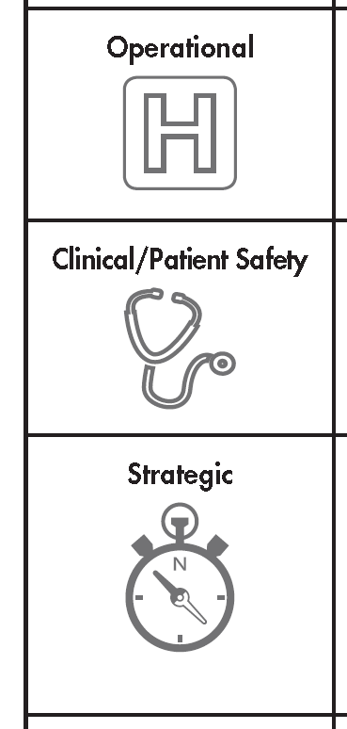
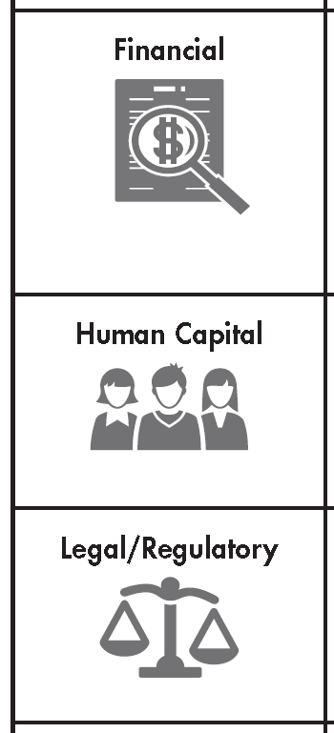
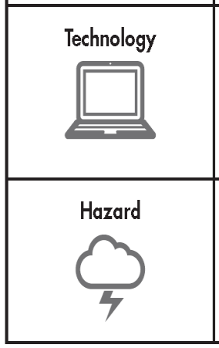
Let’s start with the Domains:
http://www.ashrm.org/resources/pdf/ERM-Tool_final.pdf

Slide 5

Operational
Impact on operations during migration
Staff training requirements, how will time be covered to continue services
How long will you need to run “dual” systems
What information do payers/regulators need and how will they access in new system
How will you release requested medical records?

Slide 6

Clinical/Patient Safety
How will new system impact documentation – flowcharts, documentation by exception
Access to computers in clinical area – How will they be kept clean?
What clinical quality metrics are available, how robust is the reporting?
What will your downtime procedures be?
What documentation policies/procedures need to updated to support the EMR?
What impact will the EMR have on patient experience – How will you message?

Slide 7

Strategic
What strategic advantage does an EMR give your organization?
Is senior leadership aware of “ramp up time” and have realistic outcomes of the cost/value of the investment?
Will your EMR align with sharing information with other organizations patient receive services from?

Slide 8

Financial
Cost of the product
Functionality of system with billing/coding products you are using
Cost of hardware to support the software
What changes to your insurance portfolio are required?
Consider the potential decrease efficiency in operations during learning curve of users of the new system
If you will need interfaces in the future, what will the cost be?

Slide 9

Human Capital
Finding IT analysts and support staff – hen’s teeth
What clinical informatisist support or staff will you need?
What “super-user” staffing will you need during go live to support staff in learning to use the system
Notes:
To provide a road map for the audience, you can repeat this Overview slide throughout the presentation, highlighting the particular topic you will discuss next.

Slide 10
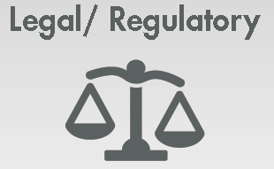
Legal/Regulatory
Have you defined what will be released as your “certified medical record” – what about meta data?
How will you put a “litigation hold” on an EMR?
Will your system meet all of the HIPAA requirements for privacy and Security
How will you maintain your log of record access/ release per HIPAA requirements?
How will your system impact your ability to report quality measures, i.e., Core Measures, Meaningful Use Measures?
What policies/procedures need to updated related to access – security levels, password use

Slide 11

Technology
Are you hosting the system, or will be in “the Cloud”, or on someone else’s server?
Is your EMR platform fixed or flexible – Meditech vs. Epic?
Will your EMR need to interface with other niche systems – PACS, LAB, Nighthawk – how will the appropriate access/ security be maintained?
What other systems will interface with your EMR to support documentation?
What additional infra-structure might be needed – upgraded secure wifi system?

Slide 12

Hazards
Current annual cost of cybersecurity globally is $500 Billion, by 2019 this is estimated to be $2 Trillion.
– Lam, Risk Manager, eTrade , ASHRM 2017
Physical safety/security of servers and hardware?
Do you need a back-up, or mirrored system?
What will your access auditing trail be?
If you use mobile devices, will they be encrypted?
How will be sure that all systems have updated patches?
Cyber security concerns anyone?

Slide 13
Oh, for the old days of paper. . . perhaps illegible handwriting wasn’t so bad.

Slide 14
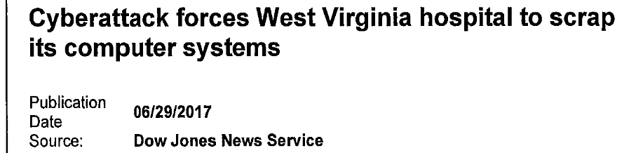
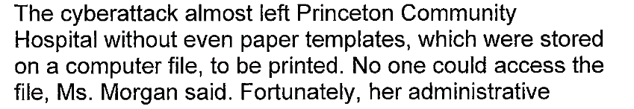

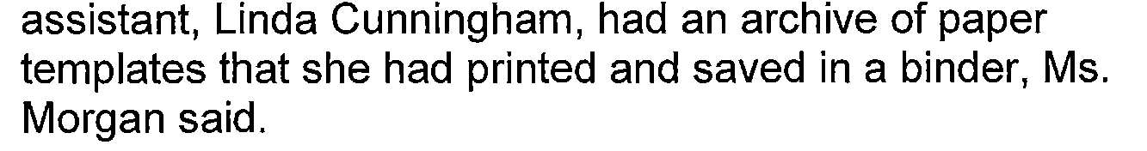
And in other news . . . .

Slide 15
Technology is a Wonderful Thing . . . . When it works.

Slide 16
One Institutions Journey with Nuance Communications – iChart
Voice recognition tool that turns dictated notes into transcribed notes
Provider dictates
Dictation goes to Nuance communications
Through the magic of technology, transcribed note “appears” in the EMR, assigned to the correct patient encounter for provider to review and sign electronically.
Signed contract with vendor 9/2008
Upwards of 80% of providers used the system
Cost-effective, more efficient transcription service
A few specialty areas maintained their own transcription services

Slide 17
Until June 27, 2017 . . . . . .
IT staff became aware that the backlog of dictated audio files were building in the queue, and transcribed notes were not being filed in the EMR
Contact with Nuance Communications revealed they had been the target of a malware attack (NotPetya) which crashed their entire platform supporting iChart transcription services (Not confirmed until July 25, 2017)
No date of resumption of services available

Slide 18
June 27, 2017 to Sept. 30, 2017
Instituted emergency operations as we had staff doing activities that were not their “normal duties”
Worked with providers to find those who would manually enter critical notes, and use other voice recognition software within our EMR (Dragon) to support operations and patient flow.
Watched the audio file backlog grow to upwards of 1500 files
Talked with Nuance daily to determine their “recovery date” for services
Scrambled to find transcription services, internally and through external vendor and set up connections for them to access the audio files to transcribe
Developed work arounds for IT analysts to file dictated notes in the EMR

Slide 19
June 27, 2017 to Sept. 30, 2017
Put Cyber insurance carrier on notice of potential claim – rider for third party vendor
Completed a HIPAA risk analysis to assure we had no lost PHI or data, and no breach reporting requirement
After extensive discussion with Nuance, determined that iChart was a “sun-setted program” no longer supported, and realized IT would need to do a build that normally takes 3 months ASAP, to support the new platform – build completed in 3 weeks.
July 25 – Met with IT staff to discuss concerns of confidentiality with “alternate duties”
Aug. 30, 2017 went live on new Nuance transcription platform
Internally worked remaining 850 audio files on the server
Sept. 30, 2017 resumed normal operations
Left to do - IT to run application to correct author of the dictated reports
Preparing proof of loss for insurance

Slide 20
What we learned . . . . . . .
Daily Operations and Safety huddles helped keep the organization informed of what was going on, fixes being put in place, and helped enlist support of providers to do manual entry and use alternate dictation software
Our configuration stored the audio files on our internal servers, other users stored on Nuances servers, had that been our case, we would have lost our audio files, and had a reportable breach
Two weeks prior to this event our IT staff had installed a patch to our servers which prevented our systems from being affected by the malware that took Nuance down.

Slide 21
What we learned . . . . . . .
Notices of the iChart being sun-setted went to leadership in the transcription department, not IT. Since the Transcription department liked the current system and did not want to learn a new system, notices were ignored and not acted upon.
By implementing emergency operations, and having staff complete alternate duties, we were able to maintain operations, without any loss in billing revenue, or affecting patient care

Slide 22

What EMR do you use?
What ERM concerns are you thinking about now?

